Slide 1






SATRE – Standard Architecture for Trusted Research Environments
Dr Christian Cole
Co-Director TREvolution
Reader in Health Informatics, University of Dundee

Slide 2
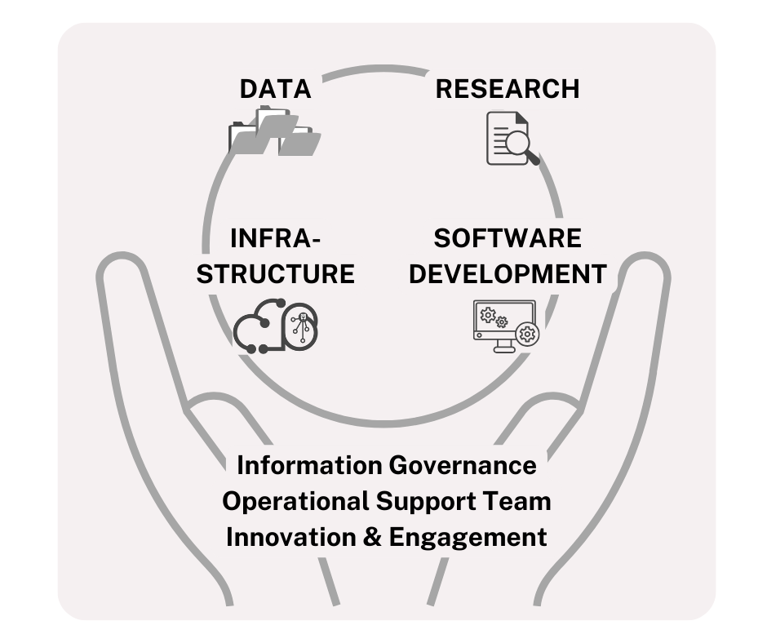

















Health Informatics Centre (HIC)
Expertise across data linkage and engineering, data science research, software development, infrastructure, information governance and innovation.
HIC is a data ecosystem, facilitating and drive research, helping building professional networks
It is the wider expert team working here that make us a Safe Haven.
HIC are data curators/ processors on behalf of data controllers. We have a balance of responsibilities
  International
  UK
  Scotland
  Locally
  Professionally
20 Years of Experience
Circa 40 Staff
>£170m project support
>400 research outputs
www.dundee.ac.uk/hic

Slide 3
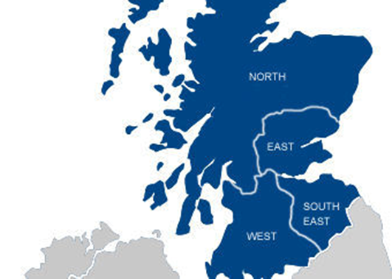




HIC & Scottish Safe Haven Network
Fulfil the needs of the Chief Scientist Office (CSO) Scotland
  Scottish Safe Haven Charter (2025) accreditation
  ISO27001 certified
  DEA accredited
HIC are 1 of 4 regional Scottish Safe Havens
  East of Scotland NHS Data
  2.2m patient records
Managed a Trusted Research Environment for >10 years
www.dundee.ac.uk/hic

Slide 4
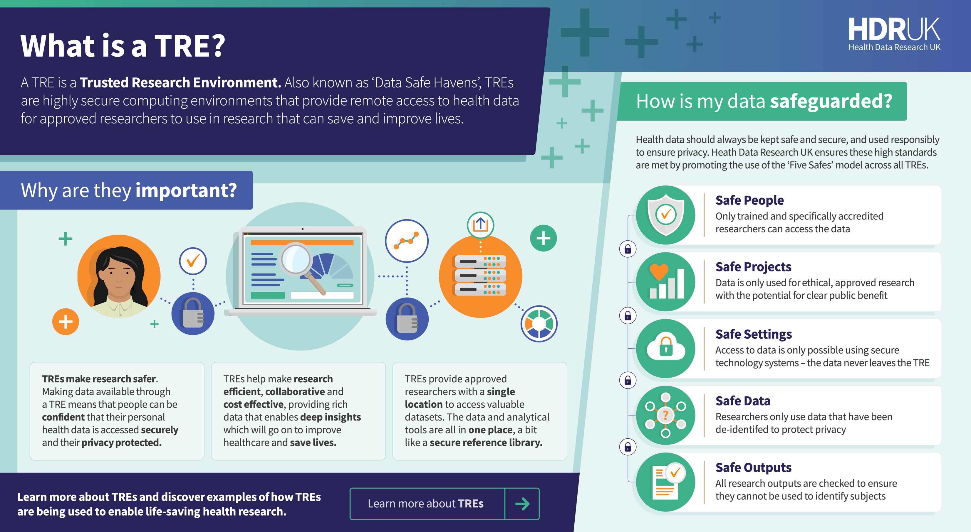

Slide 5


Slide 6

Why Does This Matter?
⚡
🔍
🔗
Fragmented landscape
Demonstrating equivalence
The federation opportunity
Improved Security
UK TREs have grown organically over 20 years solved in different ways and being managed under different regulatory frameworks (i.e. ISO 27001, DEA, NHS DSPT, Cyber Essentials).
Data controllers and funders want assurance that TREs meet a common standard. SATRE provides a shared language for that conversation.
The next frontier is multi-TRE studies linking data held by different organisations to provide access to larger and more complex datasets. That needs agreed standards for how TREs work together.
Sensitive data is an asset that is often a target for attack and needs to be protected.

Slide 7


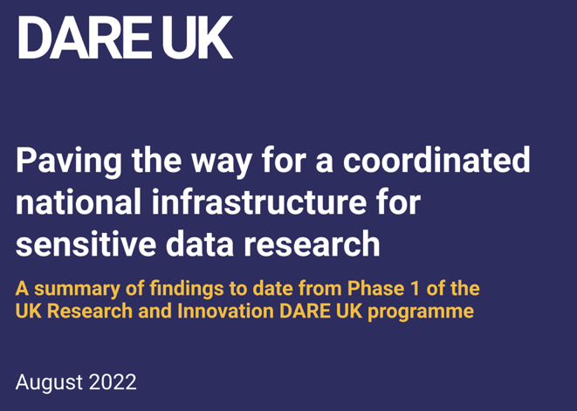




Why Does this Matter?
The desire and use of sensitive data for research in the UK and internationally is growing rapidly

Slide 8
What is SATRE?
An architecture and specification, not a product. It defines capabilities a TRE must, should or could have.
Co-designed with TRE operators, researchers and the public through active engagement and Collaboration Cafés
Lightweight and consistent with existing accreditations
Supports and enables new and existing TREs along their accreditation pathway
  Building trust with data controllers, the public, project partners and other stakeholders
Freely available - https://satre-specification.readthedocs.io
5
35
Pillars
Capabilities
185
60+
Statements
Contributing orgs

Slide 9
SATRE is More Than a Specification
PRINCIPLES
ARCHITECTURE
SPECIFICATION
Usability
Four layers — from intent to implementation
What safe delivery looks like — stated as requirements
TREs must be easy to use for researchers without compromising safety.
01 TRE Scope
5
Pillars
What does a TRE need to do?
Thematic groupings
of capabilities
Public Trust
Every decision should be defensible to the people whose data is used.
02 Capabilities
What must it be able to do?
35
Capabilities
Observability
What a TRE must
be able to do
03 Components
What happens inside a TRE must be transparent and auditable.
How are capabilities delivered?
185
Statements
Standardisation
04 Specification
Mandatory, Recommended
or Optional requirements
Common approaches enable equivalence, portability, and federation.
How do you do it safely?

Slide 10
The SATRE Capabilities
1. Information
Governance
2. Computing
Technology
3. Data
Management
4. Supporting
Capabilities
5. Federation
Info Governance
End User Computing
Data Lifecycle Mgmt
Business Continuity
Federation Governance
Quality Mgmt
Infrastructure Mgmt
Identity & Access Mgmt
Project & Programme Mgmt
Member Accreditation
Risk Mgmt
Capacity Mgmt
Output Mgmt
Knowledge Mgmt
Federation Study Mgmt
Study Mgmt
Configuration Mgmt
Info Search & Discovery
Financial Mgmt
Federation Info Security
Researcher Accreditation
Info Security
Procurement
Federation Infrastructure
Training Mgmt
Cyber Resilience
IT Service Mgmt
Federation Data Mgmt
PPIE
Vulnerability Mgmt
Relationship Mgmt
Federation Financial Mgmt
Encryption
Legal Services
New in v2.0
Physical Security
89 Mandatory Statements

Slide 11
The Specification Structure
Statement
Guidance
Importance
Mandatory
Cannot be omitted
A short, clear sentence stating one specific thing an organisation is expected to do.
Statements are intentionally brief - they tell you what is required, not how to do it.
An explanation of why the requirement matters and how it might be met in practice.
There may be many valid approaches - guidance does not prescribe a single method.
Recommended
Strongly advised
Optional
Good practice where feasible

Slide 12
Importance levels — and a complete example
Mandatory
Recommended
Optional
Cannot be omitted. This requirement is essential to demonstrate that a TRE meets the minimum standard for safety and public trust.
Strongly advised. Organisations are expected to meet this unless they have a documented reason not to. Most will and should.
Good practice where feasible. Aspirational — not all organisations will be able to meet this immediately, and that is acceptable.
Complete example — Data Lifecycle Management (3.1.04)
STATEMENT
Where a project intends to train or fine-tune machine learning models on sensitive data, you should ensure a data management plan for ML artefacts is agreed prior to project commencement.
GUIDANCE
The plan should cover the types of models supported, whether and under what conditions trained models may be exported and any additional risk mitigations required. Where AI/ML models are used operationally, the TRE may require a register of use plan and a decommissioning plan. These processes may be documented within a single document or across existing relevant policies, procedures, and operational docs
IMPORTANCE
Recommended

Slide 13

How is SATRE Useful?
Information Governance
Governance Requirements
Quality Management
Risk Management
Study Management
Member Accreditation
Allows demonstration of equivalence
Addresses fragmentation of TREs
Enables alignment to existing accreditations:
  ISO 27001
  NHS DSPT
  Digital Economy Act
  CyberEssentials
Control Alignment Table Available*
Helps TREs on their accreditation journey
Training Delivery and Management
Computing technology and information security
End user computing
Infrastructure management
Capacity management
Configuration management
Information security
Data management
Data lifecycle management
Identity and access management
Output management
Information search and discovery
Research metadata & data archiving
Supporting Capabilities
Business Continuity & Project management
Knowledge management
Financial management
* https://doi.org/10.5281/zenodo.17986198
Procurement, IT Service & Relationship management
Public Involvement and Engagement
Legal services

Slide 14

SATRE v1.0
Released October 2023
Widely adopted:
  Scottish Safe Haven Network (and Safe Haven Charter 2025 refresh)
  NHS SDEs
  Industry (i.e. Aridhia, AWS)
  The Alan Turing Institute data safe haven
  Francis Crick Institute (TRELLIS)
  50% of respondents to DARE UK 2026 survey (unpublished)

Slide 15
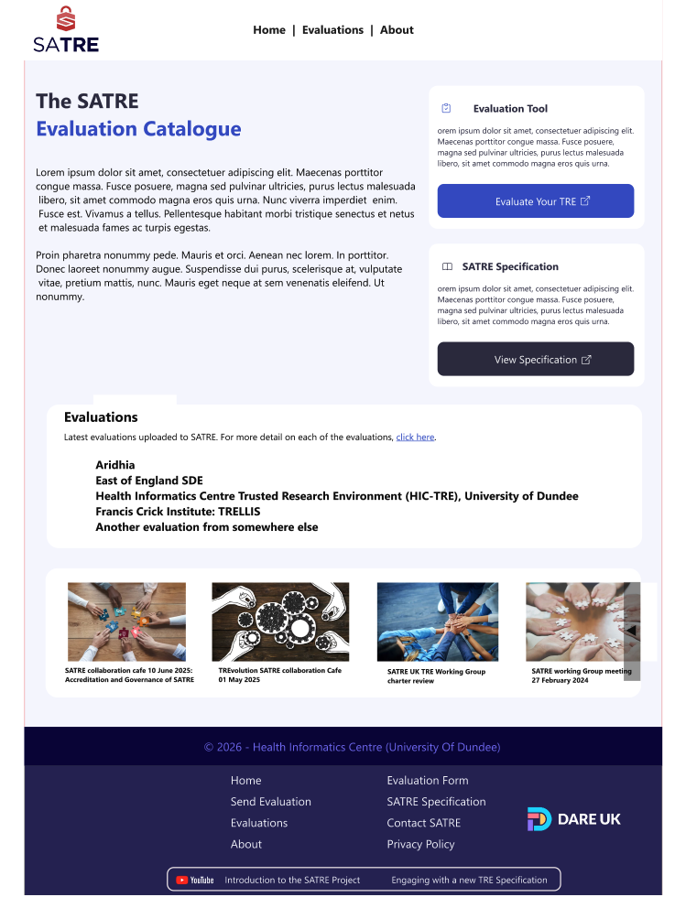
SATRE v1.0
Public Evaluations Catalogue
  update preview
https://satre.uktre.org
Repository of SATRE evaluated organisations
  Transparency and visibility
Preview

Slide 16
What’s new in v2.0: Federation Pillar
1
7
22
13
8
1
New Pillar
Capabilities
Statements
Mandatory
Recommended
Optional
5.1 Federation Governance · 10 statements · Cross-cutting capability
5.2
5.3
5.4
Member
Accreditation
Federation Study
Management
Federation
Info Security
1 statement
2 statements
5 statements
5.5
5.6
5.7
Federation
Infrastructure
Federation
Data Management
Federation
Financial Management
1 statement
2 statements
1 statement
Developed through two-stage workshops at UK TRE Conference (Leeds) · Collaboration Cafés · Open community consultation

Slide 17







Real-World Data Exemplars
Eight 12-month projects – Testing TREvolution Components
AIRR-BRIDGE
https://dareuk.org.uk/how-we-work/ongoing-activities/dare-uk-research-exemplars/

Slide 18

Transparency and Openness – Core Principle
Open Code/Resources:
  https://github.com/sa-tre
  https://github.com/sa-tre/satre-specification
Open Documentation:
  https://satre-specification.readthedocs.io
Open Communication:
  https://medium.com/satre
Explainer Videos
  https://youtu.be/auExNHEGwcc
  https://youtu.be/kzUU5ljII0Q

Slide 19

A Truly Community-Led Specification
~60 organisations engaged
Content, direction and delivery shaped by the community. For example:
  Inclusion of IG as a pillar
c. 20 Collaboration Cafés
Active involvement of the UK TRE Community
Dozens of contributed github issues
Public Involvement
Workshops identified transparency as a key requirement
Reflected in three (mandatory) statements

Slide 20
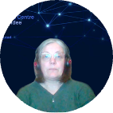
Wider Context of SATRE
SATRE Community Interest Group
  Long-term view
  Input from Public, NHS SDEs, Industry collaborations, National Institutes, UK Statistics Authority
National UK Organisation Involvement
  UKDS, UK Statistics Authority, Department for Health & Social Care (incl. SDEs), National Safe Haven
  Capability Mapping between ISO/DEA/DSPT/CyberEssentials
https://zenodo.org/records/17986199
https://zenodo.org/records/16837077
Jenny Johnston
Governance Manager & Operations Lead
HIC, University of Dundee

Slide 21
International Impact
EOSC-ENTRUST Architecture Blueprint
  SATRE tested in European Secure Processing Environments (SPEs)
South & Central America
  Spanish Translation of SATRE
Discussions with TRE operators in multiple countries

Slide 22

SATRE
First UK definition of a TRE
  Based on a capability framework
Provides a mechanism for TRE equivalence and transparency
Fills an accreditation gap which is being adopted across domains, industries and borders
v2.0 is a new framework for defining how data federations are initiated and managed

Slide 23

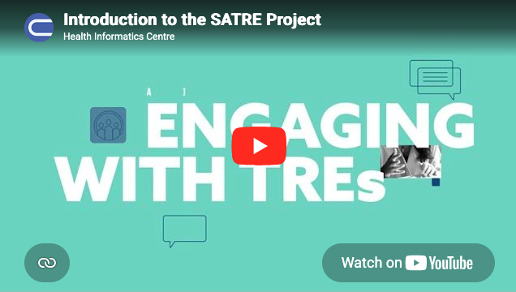


Engagement Encouraged!
  satre-contact@dundee.ac.uk
  https://satre.uktre.org
  https://satre-specification.readthedocs.io

Slide 24


Acknowledgements
www.dundee.ac.uk/hic
The Team
Tim Machin (UCL)
Simon Li (Dundee)
Gordon Milligan (Dundee)
Jenny Johnston (Dundee)
Alba Crespi Bioxader (Dundee)
Katie Oldfield (Research Data Scotland)
Antony Chuter (Public Member)
Special thanks:
Operator, academic, public and industry contributors
Previous collaborators
Martin O’Reilly (Alan Turing Institute)
David Meredith (STFC)
Sonya Coleman (Ulster)
Dermot Kerry (Ulster)
James Hetherington (UCL)
Jillian Beggs (Public Member)
Funded by:

