Slide 1
Why we adopted SATRE
Ross Stiven
Aridhia
15 Jan 2026

Slide 2
Agenda
Intro:
  Who I am
  What Aridhia is
What is SATRE
Why we like SATRE
How we scored our TRE
Why we do this
Gaps in SATRE

Slide 3
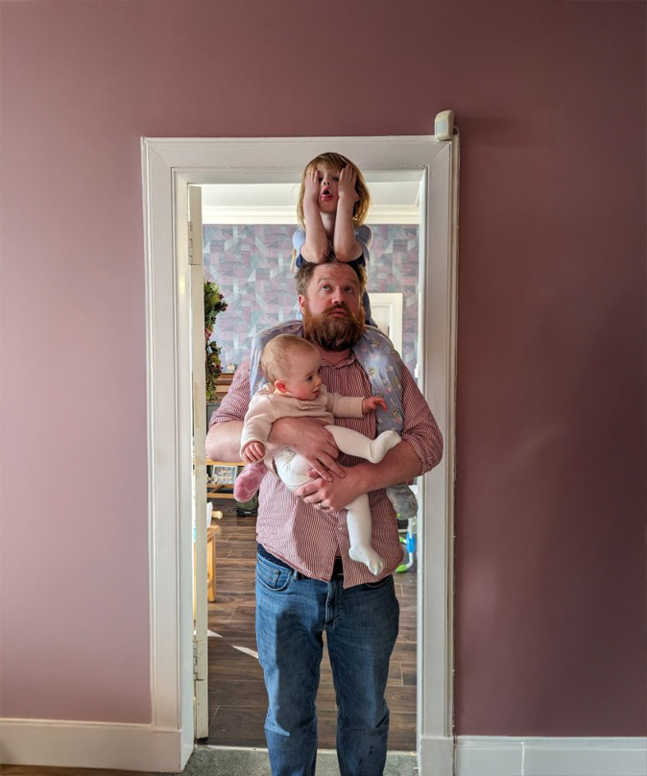
Intro
Aridhia and me
My Career:
Started as a data analyst
Became a Product Manager by accident
Have worked in public and private sectors
Have been with Aridhia for 4 years
Aridhia:
Based in Scotland
Commercial TRE provider
Clients in the UK, EU, US and Australia

Slide 4
What is SATRE
An open specification for a TRE
Developed by DARE UK
SATRE has four sections:
  Information Governance
  Computing Technology
  Data Management
  Supporting Capabilities
Aridhia were an early adopter

Slide 5
Why we like SATRE
Three reasons
Open– this drives up standards
Clear – TREs are still ill-defined (e.g SDE, SPE)
Not just tech – TREs are not just a secure box

Slide 6
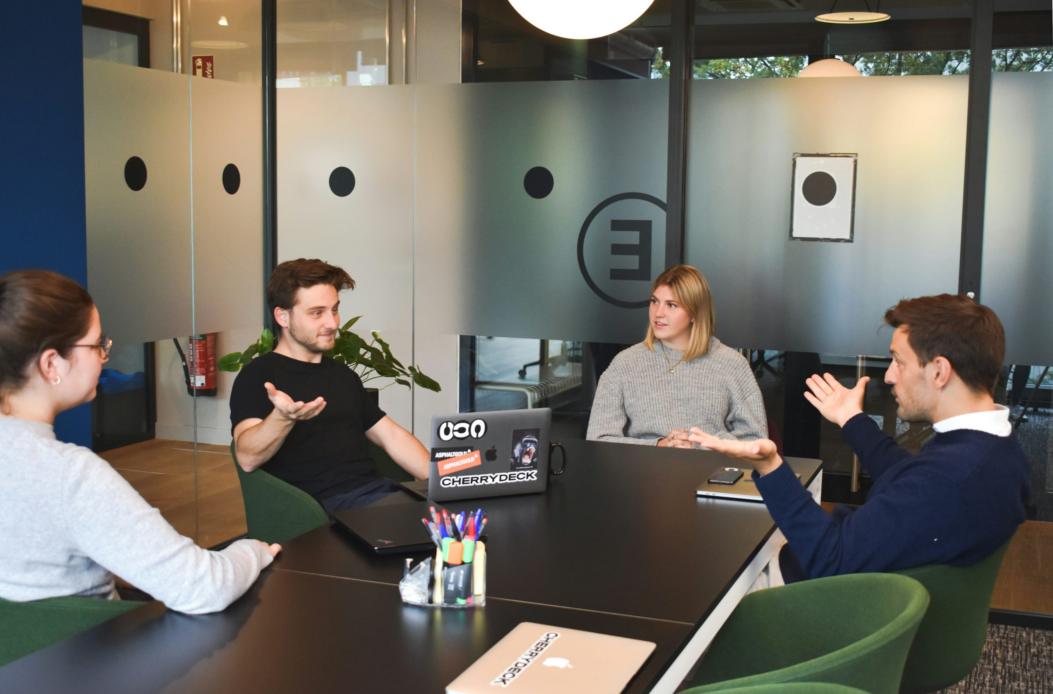
How we scored our TRE
We had a meeting

Slide 7
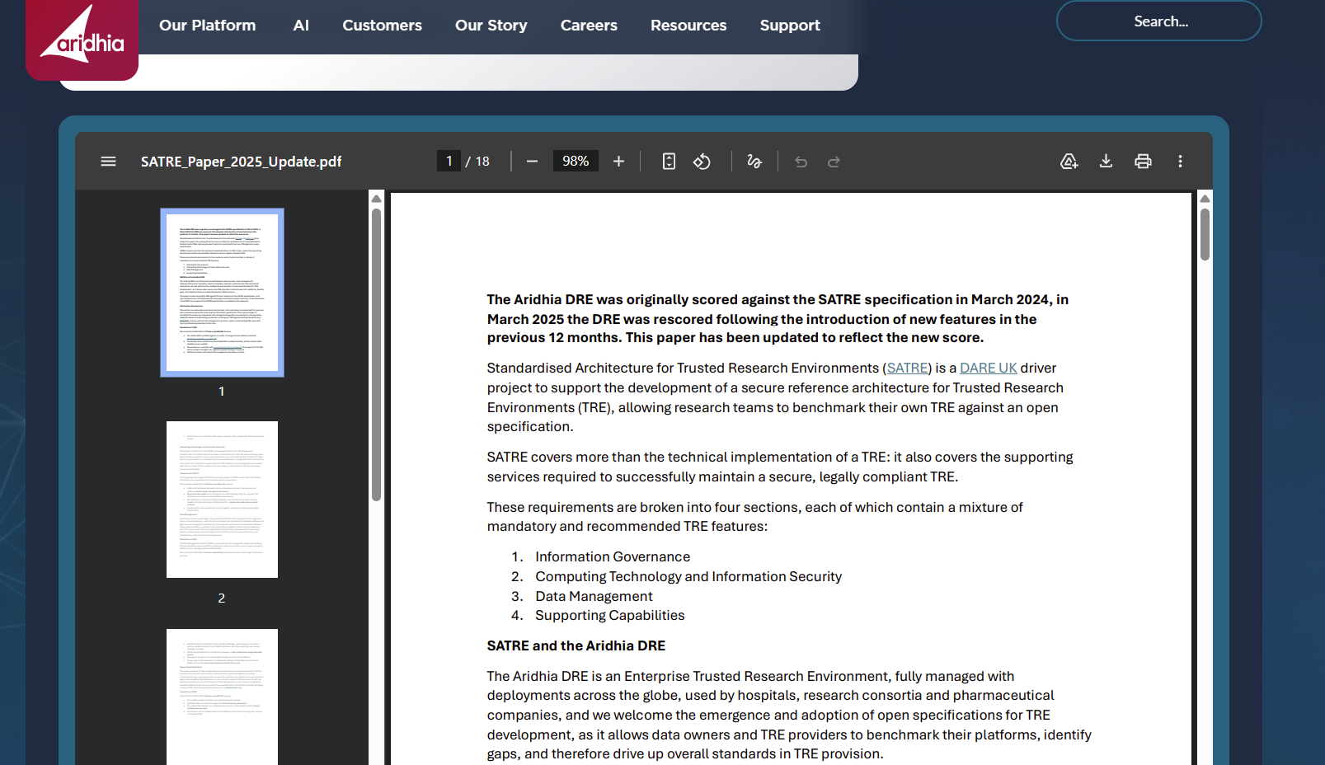
Results
The SATRE Whitepaper

Slide 8
For the record…
Our 2025 Scores
Information Governance 77/80
Computing Technology and Information Security 119/122
Data Management 54/62
Supporting Capabilities 30/30

Slide 9
Why do we do this?
Two reasons
An internal yardstick – what does the community think? How do we compare?
External communications – what is a TRE? How do we define it?

Slide 10
Let’s be cynical
Just for a minute
Internal Yardstick - Our platform holds sensitive data
External communications – It should be embarrassing for us not to have a public SATRE score

Slide 11
Gaps in SATRE
What’s missing?
Metadata Catalogue – currently only one line item
Data Federation – not mentioned
AI in TREs – could be lawyered, but…..

Slide 12
Resources
DRE SATRE Assessment:
https://www.aridhia.com/assessing-the-aridhia-dre-against-the-satre-specification/
Medium:
https://medium.com/@aridhia/beyond-satre-the-future-of-trusted-research-environments-c6f052f0a055
Ross Stiven:
ross.stiven@aridhia.com
https://www.linkedin.com/in/ross-stiven-bbb21b15a

