Slide 1
Evidence-led curation skills for sensitive data
Hollydawn Murray
Head of Open Science, Research Culture & Impact​

Slide 2
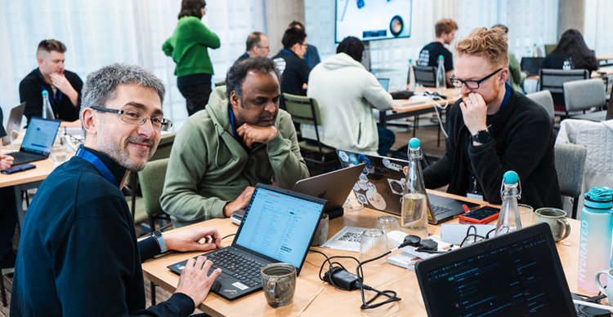
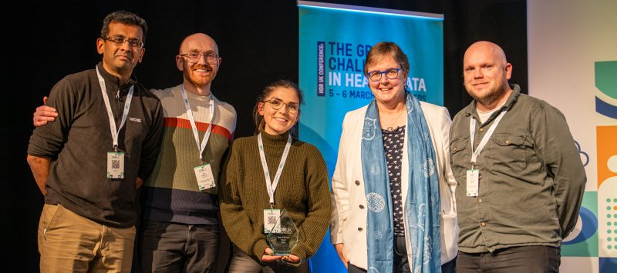
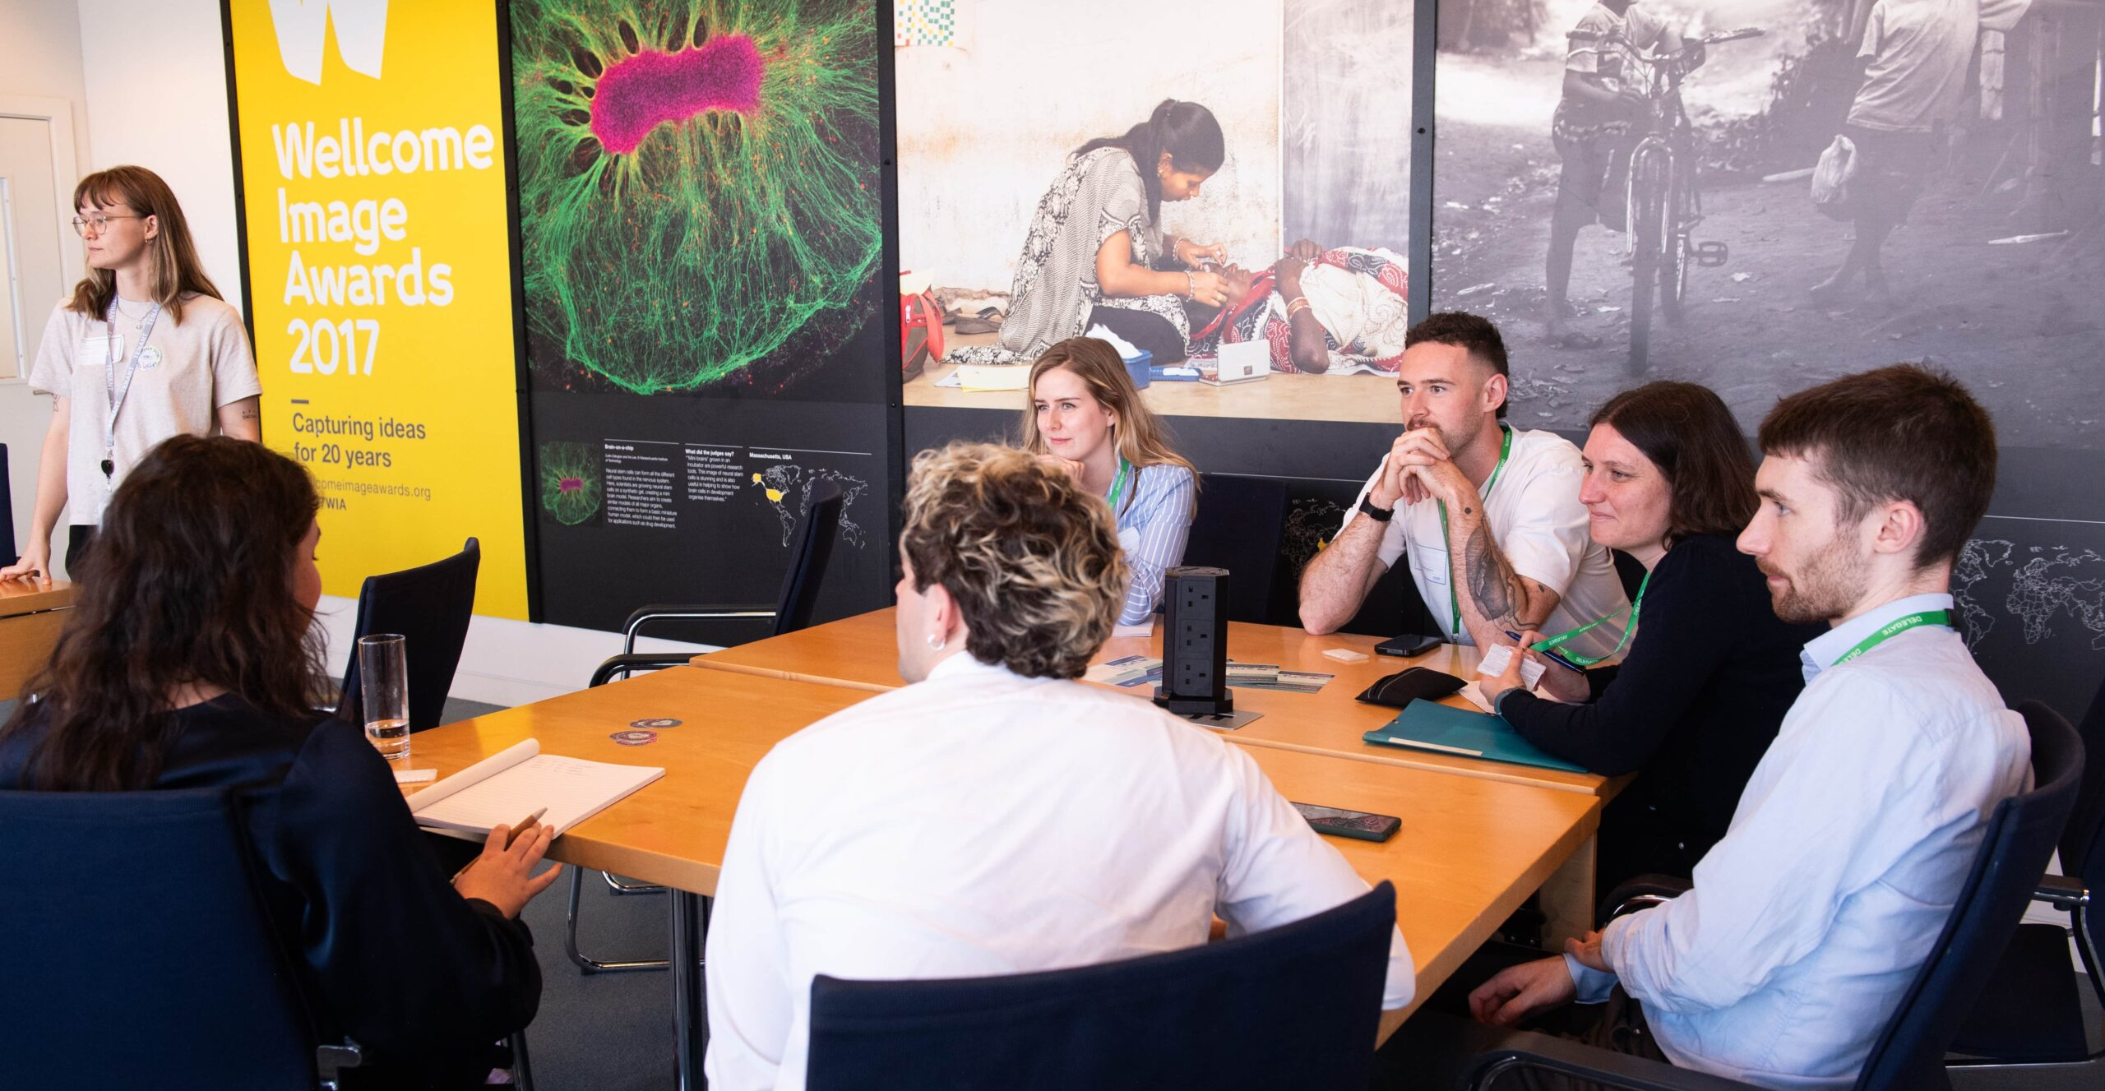
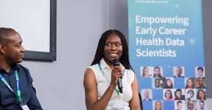
People, skills, and perspectives
Find Data
Access Data
Link Data
Curate Data
Analyse Data
Create Insights
Improve Health
Software Developers, and Research Software Engineers
Statisticians
Computer Science Architects
Data Analysts
Legal, Ethical, IG, PPIE Experts
Clinicians & Practitioners
Project Management and Operational Leadership
Public and Patients

Slide 3


National capacity infrastructure to deliver sustainable impact
HDR UK’s Capacity Building programme is a nationally coordinated, cost-effective training infrastructure that builds instant on-the-job capability while connecting communities and accelerating research impact.
Building a sustainable training infrastructure
User friendly online learning platform with 44,000+ engaged learners across the UK and globally
Flexible platform allowing modular, reusable training content, fully scalable while reducing costs
Building a comprehensive training catalogue comprising HDR UK and partner led courses aligned to UK priorities
Maximising ROI though capability
Training focused on applied, delivery ready skills, generating instant "on-the-job" impact
Building interdisciplinary skills to maximise return on investment and support retention
Working towards a programme of career-focused training sponsored by industry partners
Connecting communities of future leaders
Network of 800+ comprising ECRs, technical specialists and more, spanning institutions, regions and disciplines
Faster knowledge-sharing, increased collaboration, and improved problem solving
Building a cohesive, future-facing UK research workforce
By increasing the sustainable provision of robust, on the job learning while growing a connected community of interdisciplinary, digital-ready researchers, this approach strengthens the UK research ecosystem and speeds up the pace at which research delivers public benefit.

Slide 4
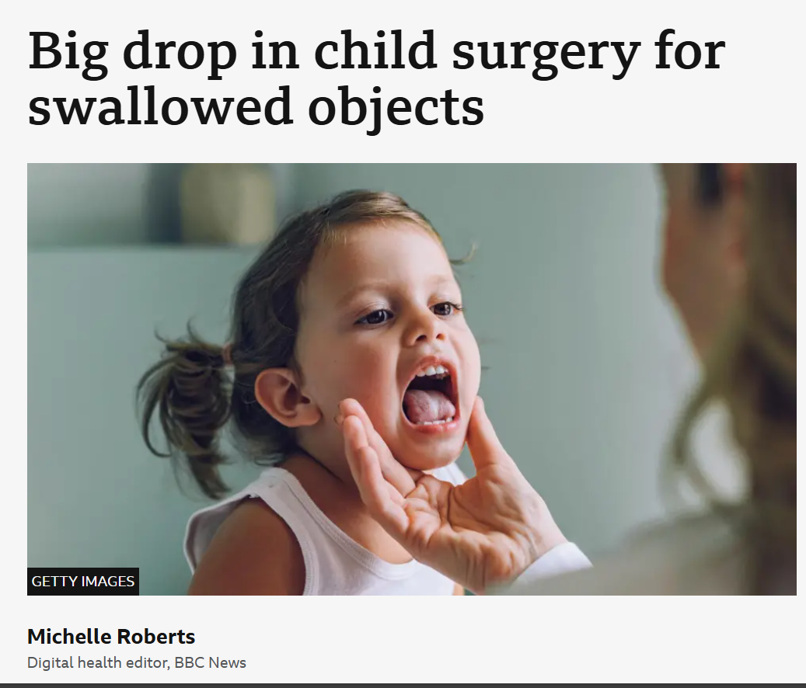
Current state of play
80% of the effort is curating data
Effective curation is not a solitary task but a collaborative effort that spans multiple teams and disciplines and it “can be done well or badly, and there is often substantial reasonable disagreement on the best way to do it”.
80% of the effort is curating data
Effective curation is not a solitary task but a collaborative effort that spans multiple teams and disciplines and …
“It can be done well or badly, and there is often substantial reasonable disagreement on the best way to do it”.
Notes:
Anecdotally, conversations with those working in these roles generally reveal significant variation in both training and curation processes across different workplaces and data modalities – and despite frequent discussions about the data curation skills gap, there is limited concrete evidence to quantify its extent.
But why does this matter? Such skill gaps risk creating barriers to the progress of research and are compounded for sensitive data.
And I think Ben Goldacre really summed up the current state of play quite well: data curation can be done…

Slide 5
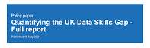
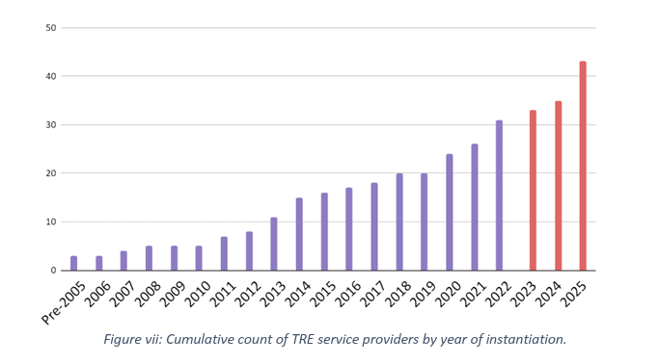
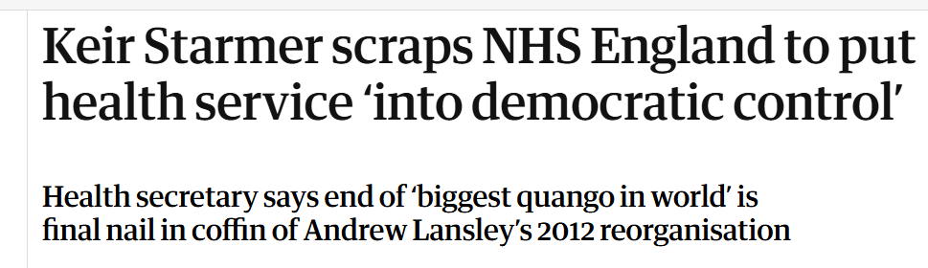


The backdrop

Slide 6















Evidence-led curation skills for sensitive data
Hollydawn Murray
Brittany Blankenship
Sarah Cadman
Understand the sensitive data curation skills and needs of data professionals, and support them by piloting evidence-based training to strengthen curation in TREs and SDEs.
Susmita Datta
Magalie Guinard-Duff
Simon Hettrick
Leigh Tate
Ben Thomas
Michelle Evans
Notes:
.

Slide 7
Our approach
Conduct a rigorous and complete analysis of the current status of data curation skills and needs for sensitive data across UK’s sensitive data infrastructure
Develop an evidence-led, prioritised list of skills gaps in response to the landscape review
Deliver a ‘proof on concept’ curriculum and test a train the trainer model -which could be generalisable/remove barriers/coordinated across sensitive data infrastructure
Foster a collaborative network of stakeholders through an annual Skills Summit, facilitating ongoing dialogue and improvement in sensitive data skills development.

Slide 8


Where we’re at
10 diverse key informant interviews
Co-development of skills survey with Oversight Group
87 full survey responses
3 targetted focus groups (>20 participants)
Recommendations for key stakeholders
(March)
Landscape report of skills gaps
(March)

Slide 9
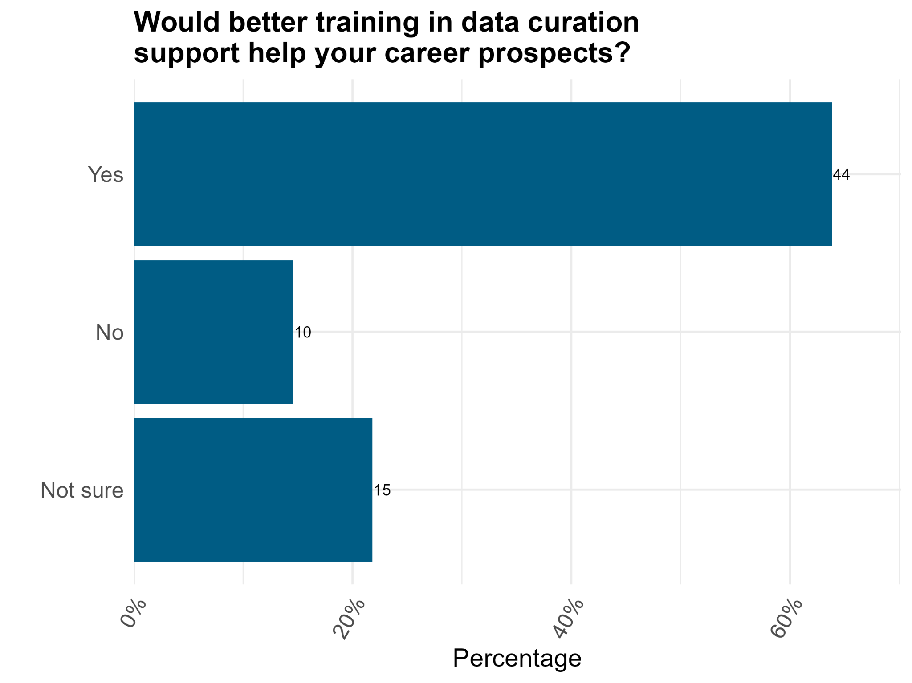
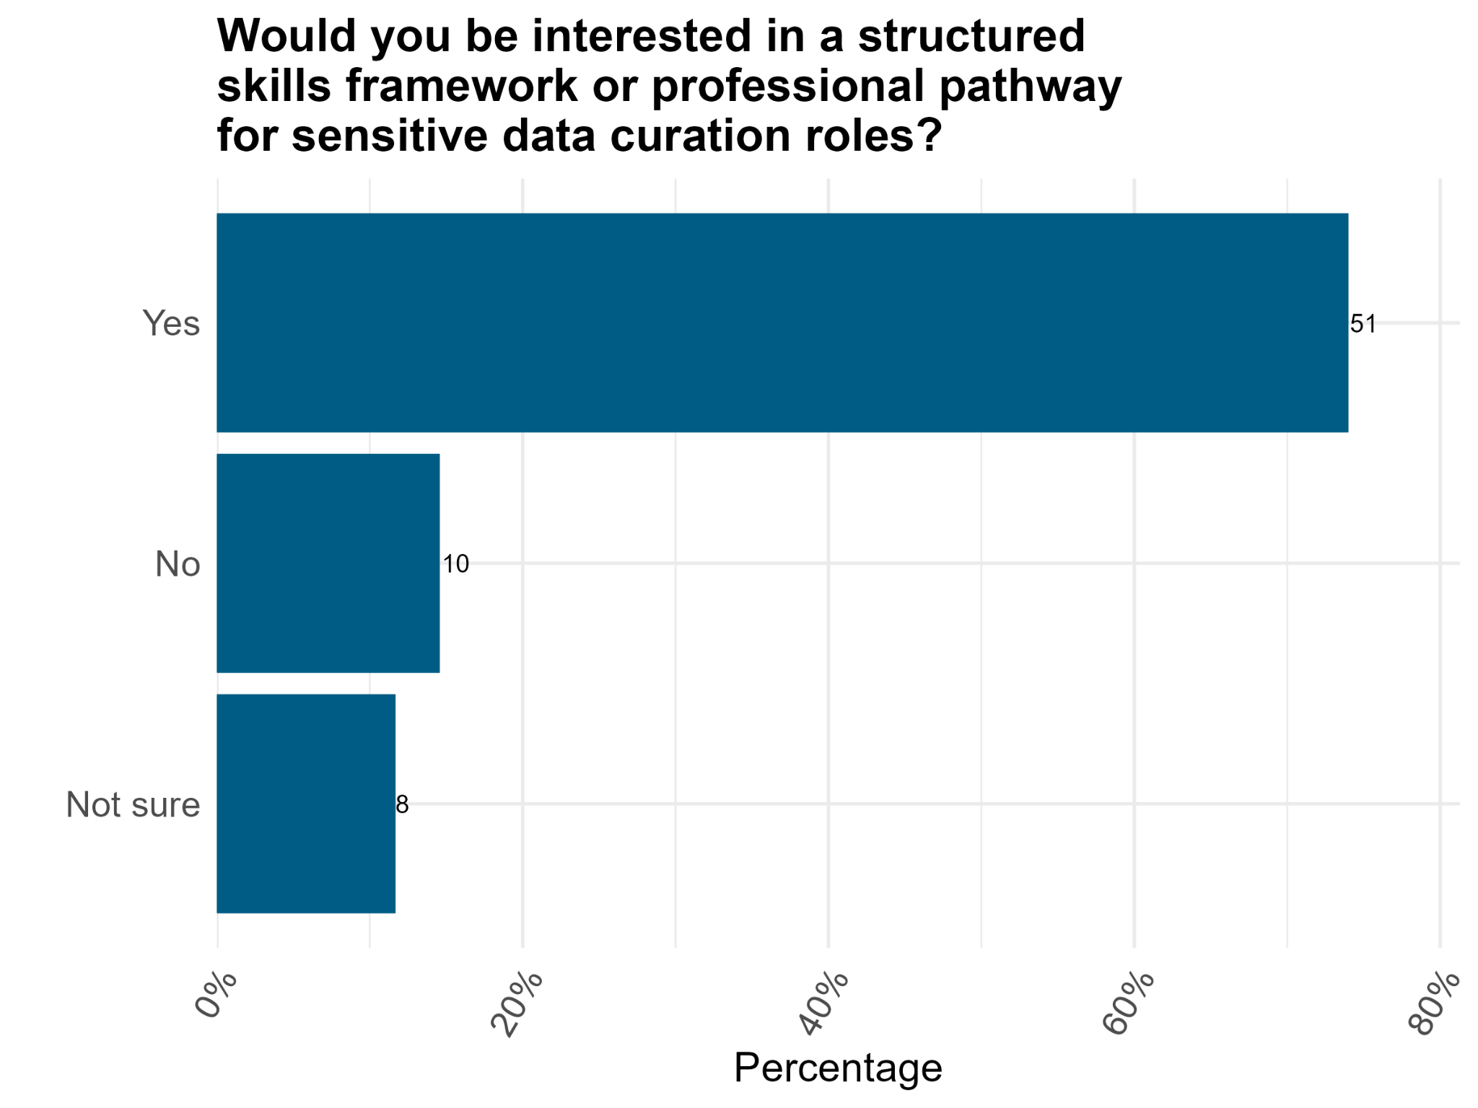
On careers and professional pathways

Slide 10
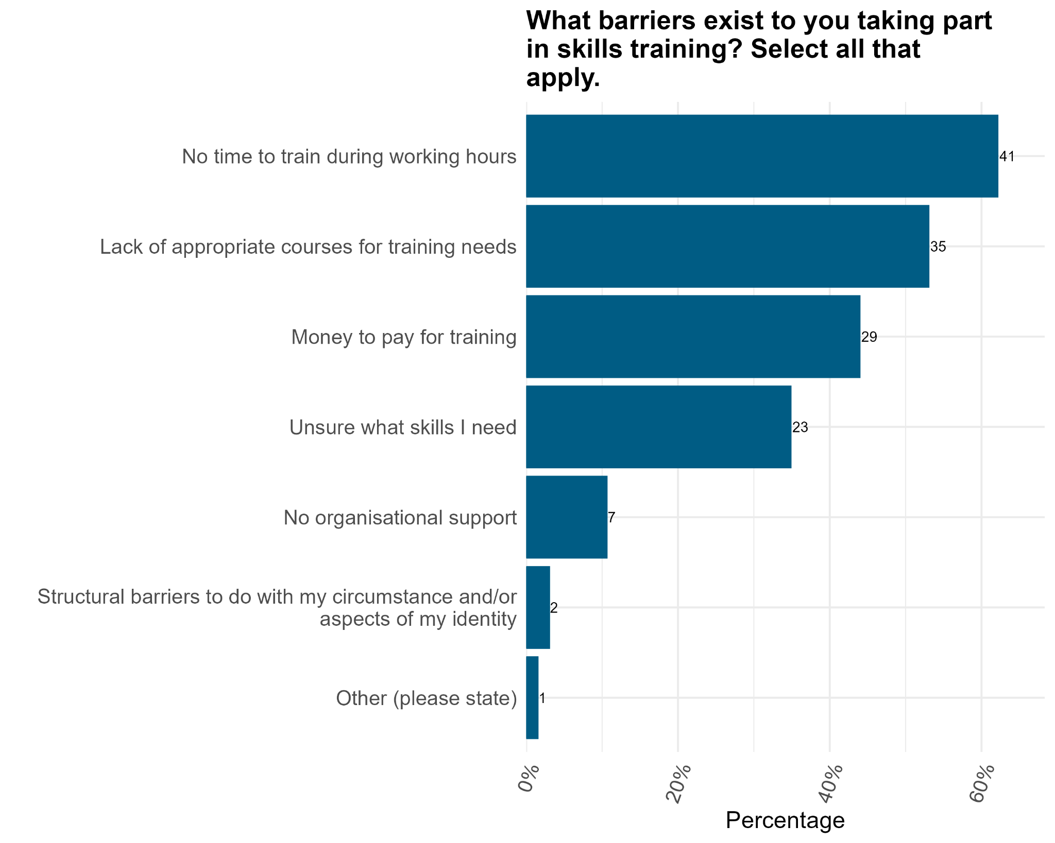

On the topic of training
[There is] a huge range of courses, and, yes, you do get that paralysis thing; I don't know what to choose. Then there's also a lack of courses that are more specifically about sensitive data curation and handling sensitive data, so there's a funny imbalance there. It's too much choice and not enough choice at the same time
Focus group participant
Only 5% of respondents reported having full training in curation available to them; majority of training is self-led or online.

Slide 11
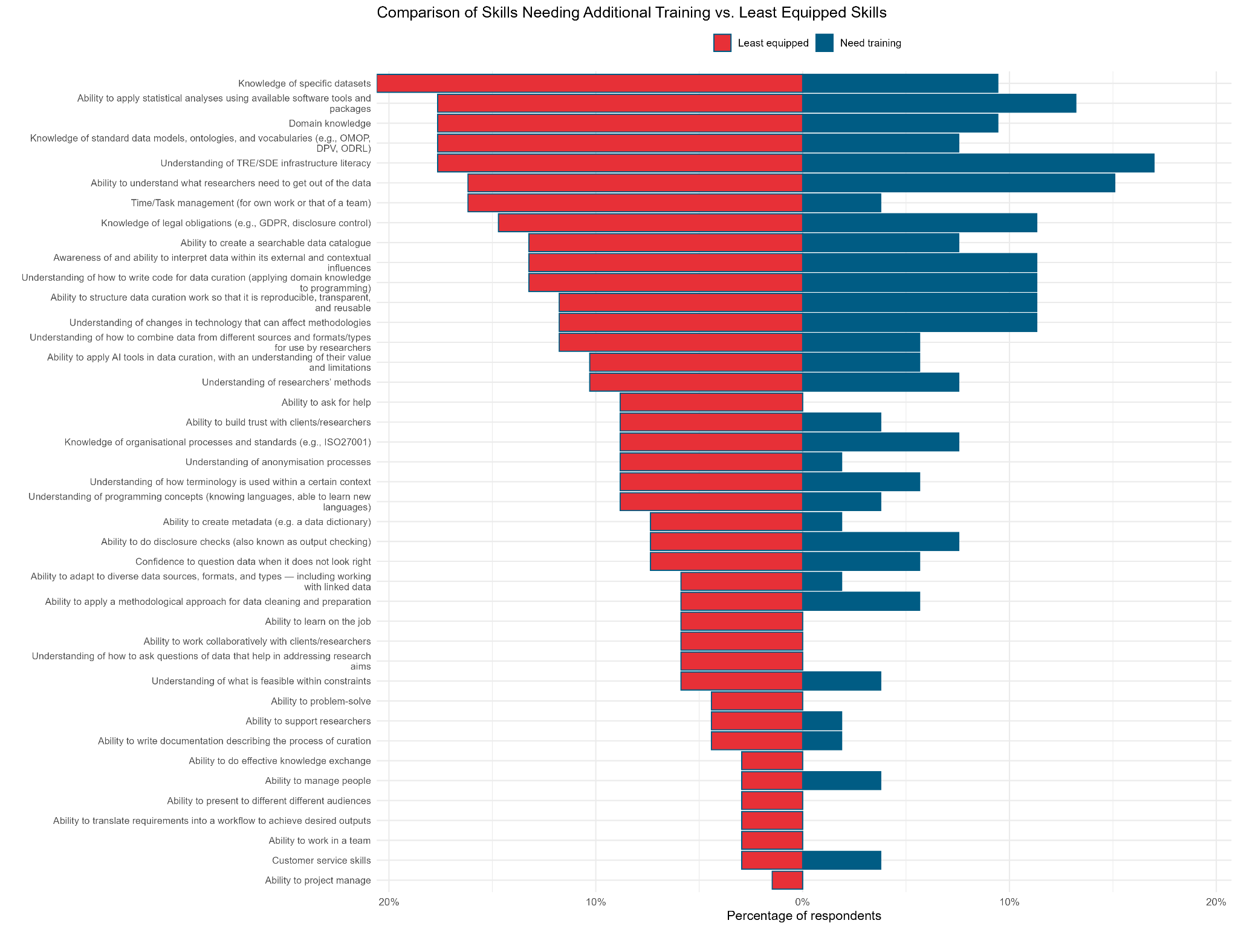

And skill gaps
Several skill gaps exist, across career stages and diata types, despite the central role curation plays in data quality..

Slide 12

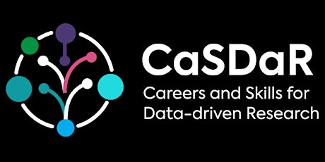

Next steps
Develop and pilot a foundational TRE Literacy curriculum
Cross-discipline curriculum will embed high-priority skills (including legal obligations and emerging AI considerations) within applied learning
Test a ‘Train the Trainer’ model in TREs
Use a flipped classroom model, combining self-led online modules with in-person workshops, providing flexibility and sustainability/scalability.
Improve sector-wide connectivity and visibility of skills development activity
Strengthen knowledge exchange, surface existing training and communities of practice, and align future priorities, including via an in-person Skills Summit

Slide 13


A snapshot of recommendations
How stakeholders can help
Training providers
TRE operators
Data & information governance
Develop training covering priority areas
Coordinate across infrastructures to support portability of skills and staff mobility.
Support interpretation of legal obligations (including/beyond GDPR) as a core component of data curation
Engage TRE operators and curators to ensure training is applicable across settings and career stages
Support skill development across career stages through participation in, and feedback on, new training provision
Promote consistent governance frameworks across TREs acknowledging TREs operate under diverse legal/governance bases
Adopt evidence-based insights from the report into relevant new and existing skills frameworks
Recognise sensitive data curation as a technical skill in roles and career pathways
Strengthen recognition of sensitive data curation as professional skillset by formalising expectations in governance standards, oversight frameworks.
| 13

Slide 14
In summary
Strengthening skills and capability in sensitive data curation
Evidence
Insights
Action
10 diverse key informant interviews
Clear evidence of wide variation in sensitive data curation practice
Skills survey co-designed with expert Oversight Group
87 full survey responses across sectors, career stages, and data types
3 focus groups (>20 participants) to interrogate and contextualise survey findings
Only ~5% report having full, appropriate training; most learning is informal or self-directed
Majority of respondents believe curation skills positively impact their career development
Strong appetite for:
A skills framework
A professional pathway
Mapping least equipped against needs external support shows priority gaps:
TRE / SDE literacy
Statistical analysis
Domain knowledge
Understanding user needs
Main barriers: lack of courses + lack of protected time
Landscape report of skills gaps
Targeted recommendations for stakeholders clarifying roles and responsibilities
TRE literacy curriculum
Testing train the trainer model in TREs
[There is] a huge range of courses, and, yes, you do get that paralysis thing; I don't know what to choose. Then there's also a lack of courses that are more specifically about sensitive data curation and handling sensitive data, so there's a funny imbalance there. It's too much choice and not enough choice at the same time
Professionals desire both skills frameworks and practical training, but formal provision is limited.

Slide 15
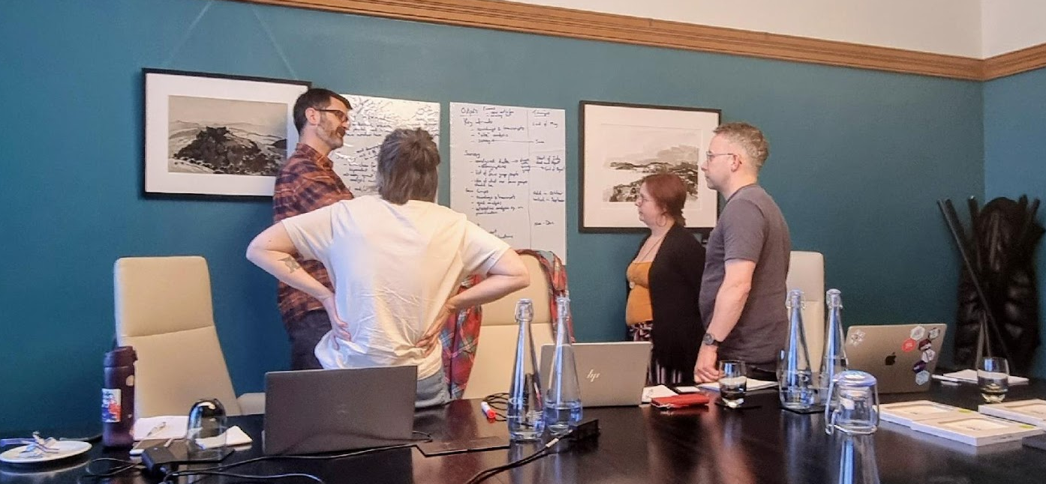
Thank you, let’s chat!
What are your immediate reactions?
What surprised you (what didn’t)?
Do these results align with your own experiences?

