Slide 1
"AI, Aye Aye Captain! Navigating the Basics of Artificial Intelligence"
"Smart Stuff: How AI Is (Not) Taking Over the World (Yet)"
"Artificial Intelligence for Real People"
"Robots, Really? A Fun Dive into AI"
"Ctrl+Alt+Intelligence: A Friendly Intro to AI"
"AI for Humans: No PhD Required"
"Hello, World! Meet AI“
‘fun’ suggestions from chatgpt
Presentation for SDAP by
Jo Webb, UKDS
17 June 2025

Slide 2
And a bit more tailored…
Beyoncé-Inspired Titles:
"Who Run the World? AI!"
(Inspired by Run the World (Girls)
"Single Bots: All the AI Ladies (and Gents)"
(Inspired by Single Ladies)
"Upgrade You: How AI Is Leveling Us Up"
(Inspired by Upgrade U)
"Crazy in Love... With AI"
(Inspired by Crazy in Love)
"AI Formation: Get in Knowledge Formation"
(Inspired by Formation)

Slide 3
Who am I?
Jo (Joanne) Webb is Associate Director of the UK Data Service and serves as the Head of Department for the UK Data Archive at the University of Essex. She brings over a decade of experience in managing research infrastructure, with a strong background in project management, governance, and operational leadership.
Thanks to chatgpt
Interested in organisational change, risk management and governance (and AI’s impact on them).

Slide 4
What I am covering
What is it?
  Types of AI
  What is Gen AI
  Examples of programs
The good
  Timesavers
The Bad
  Challenges: bias, unreality, quality
The ugly
  Governance issues:
    Assessing risk
    National policy
    Impact on jobs
    Local/ employer policy and training

Slide 5

What DO I MEAN TODAY ABOUT AI?

Slide 6
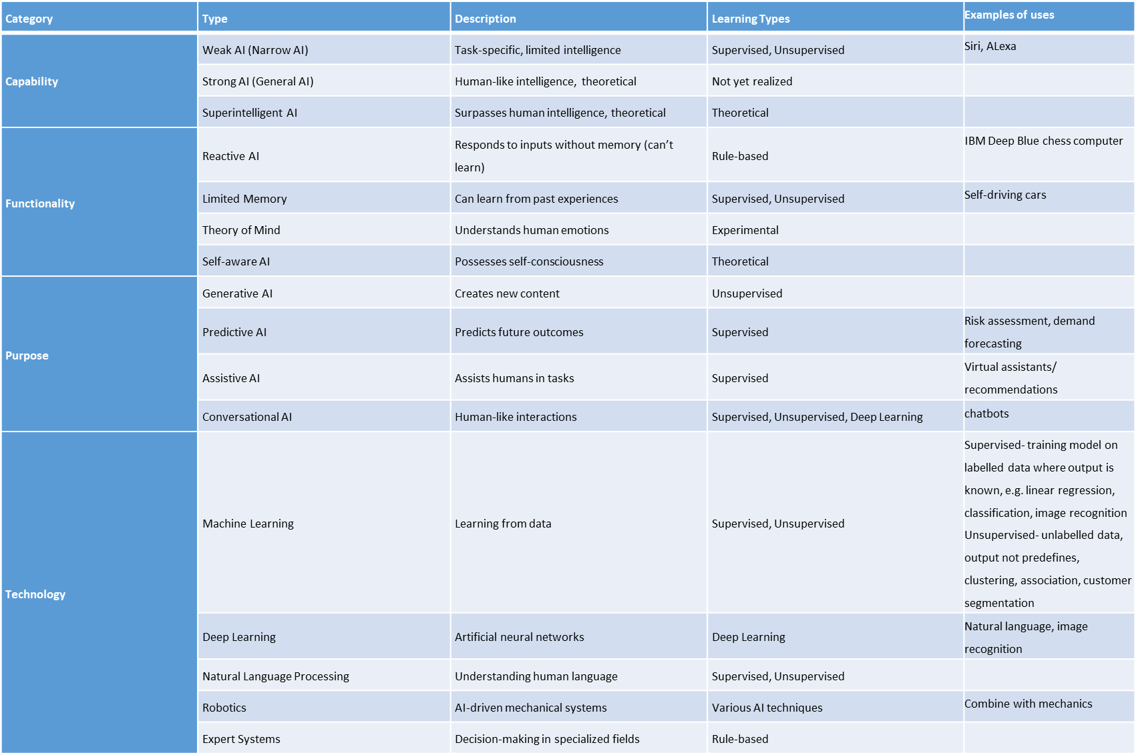
Categorising AI
AI types chart
Adapted from table on https://www.gosearch.ai/blog/breakdown-of-different-ai-types-and-models/

Slide 7
Categorising AI
AI types chart
Adapted from table on https://www.gosearch.ai/blog/breakdown-of-different-ai-types-and-models/

Slide 8


What is Generative AI (GenAI)?
Creates new content, such as images, videos, audio, text, 3D models or other data, using machine learning models [learning patterns from existing examples]

Slide 9



You can input a text description, and DALL·E
will create original, high-resolution images
based on your prompt.
Images, video, audio and graphics, poems
Music

Slide 10


Apparently good at acronyms!
AI for research: the ultimate guide to choosing the right tool
DeepDream adjusts the image to maximize certain
features to create a surreal and dream-like version of
the original image.

Slide 11


Slide 12
The good
Timesaving ideas:
Job descriptions
Summarising documents particularly legal documents, suggesting negotiation points or possible compromises
Creating lay summaries
Spotting trends in data
Getting you started – get over the blank page (hard emails)
Meeting minutes
Writing and personalisation
Brand development
Social media posts

Slide 13
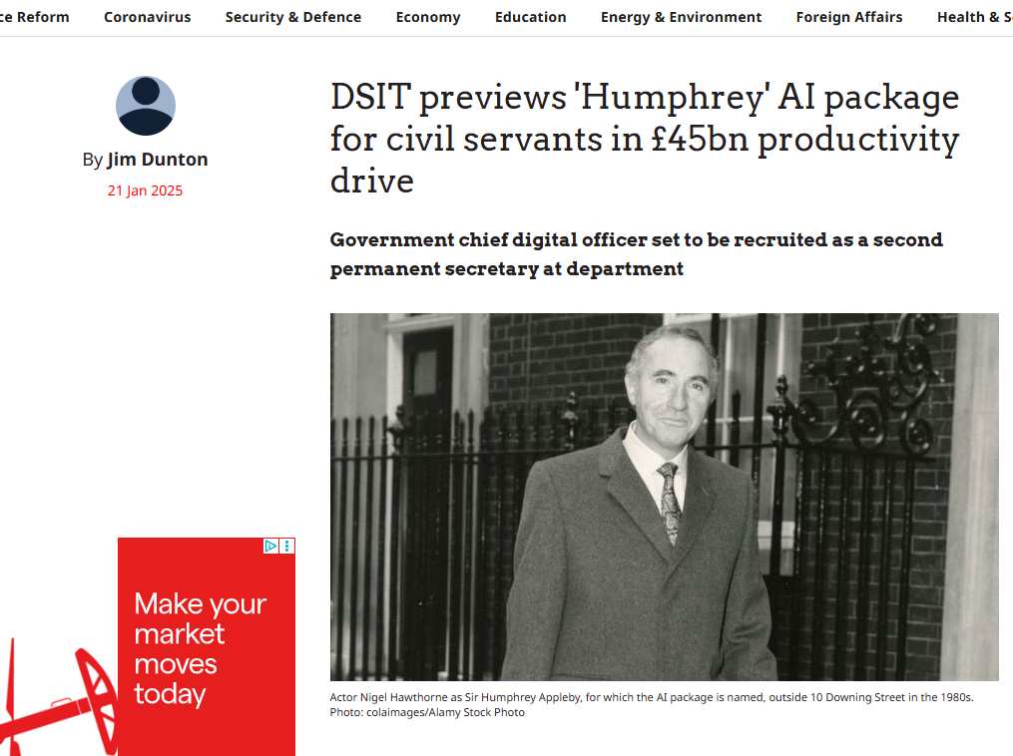
https://www.civilserviceworld.com/professions/article/dsit-humphrey-ai-package-civil-servants-45bn-productivity-drive

Slide 14
UK government trial finds AI could save civil servants nearly 2 weeks a year
The trial involving 20,000 civil servants found that using generative AI such as Microsoft 365 Copilot to assist with everyday tasks – including drafting documents, summarising lengthy emails, updating records, and preparing reports – saved users an average of 26 minutes per day.
ADA Lovelace Newsletter 05 June

Slide 15
The bad
Bias
Unreality
Copyright issues
Quality
Deepfakes

Slide 16
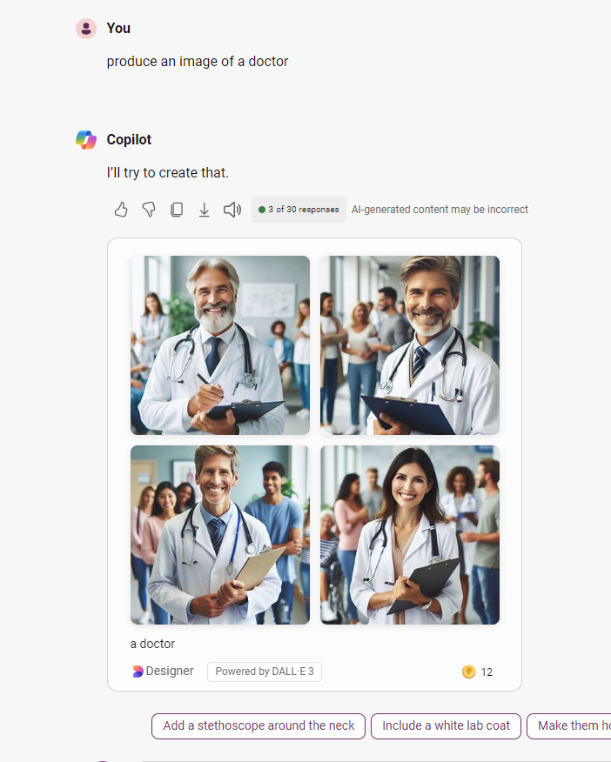

Bias
Co-pilot Oct 2024
Chatpgt 20 May 2025
93% training data for chatgpt is in English
(OpenAI https://arxiv.org/pdf/2005.14165)

Slide 17

UnrealITY https://goldpenguin.org/blog/ai-vs-human-art/

Slide 18


Slide 19


Slide 20
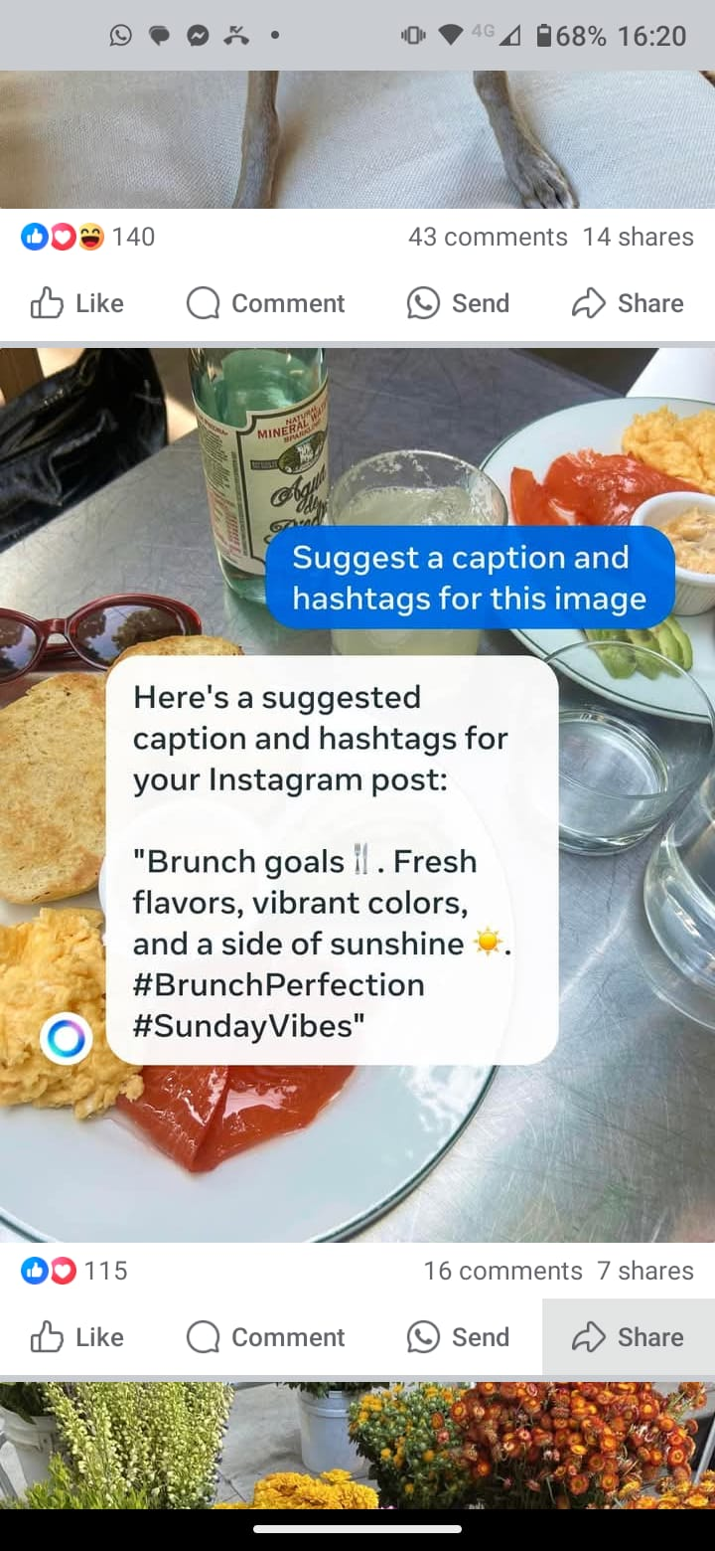
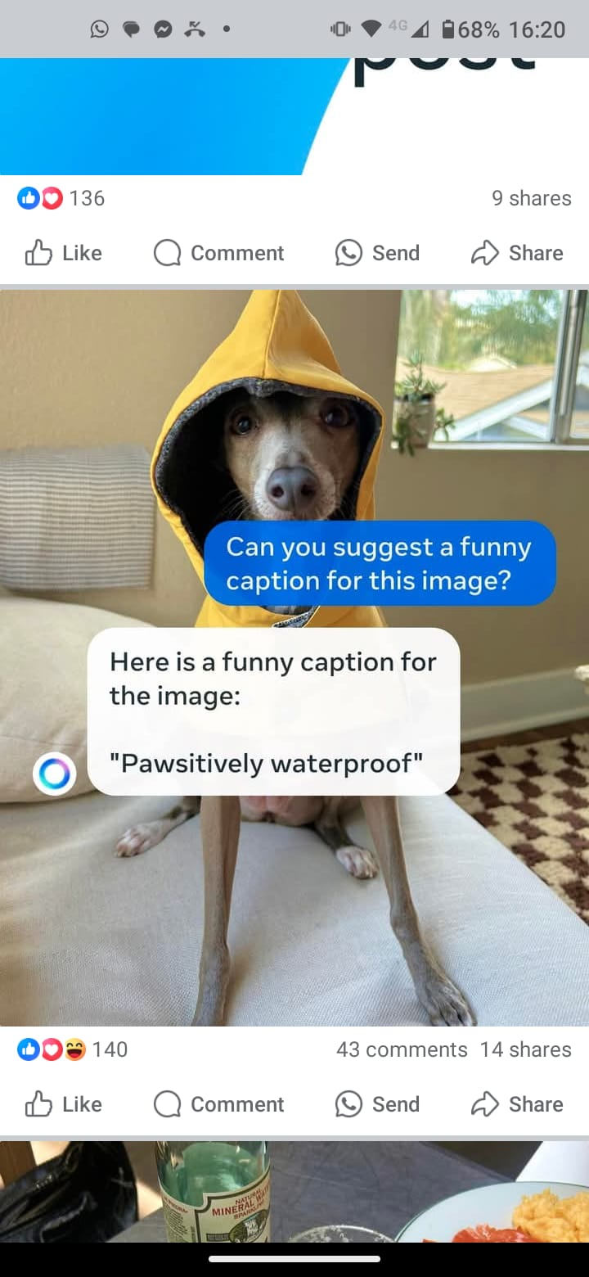
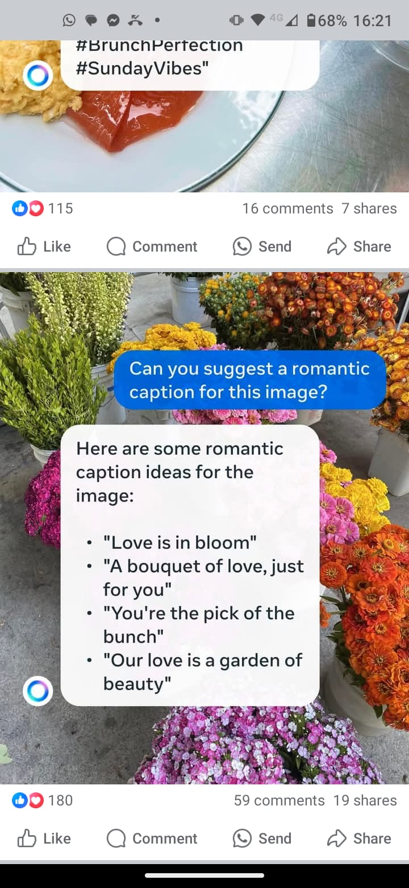
QUALITY

Slide 21
The ugly
aka things you’ll probably need to sort out in your roles

Slide 22
Governance issues
How do you assess risk
Policy and governance- national level
Policy and guidance- employer level

Slide 23
Risk strategies and policies
Big 4 (Deloitte, EY (Ernst and Young), KPMG and PwC
AI is not a risk in itself, but risk strategies need to be reviewed in light of the impact AI has on existing risks.
How will it impact current information security
How will it impact researcher behaviour/ breaches
Staff retention

Slide 24
Good sources for risk strategies
Baquero, JA et al (2020) Derisking AI by design available at: Derisking AI: Risk management in AI development | McKinsey (accessed 09 November 2023)
Deloitte (2018) AI and Risk Management Available at: AI and risk management (deloitte.com) (accessed 08 November 2023)
KPMG (2018) AI Risk and Controls Matrix, available at: AI Risk and Controls matrix (kpmg.com) (accessed 09 November 2023)
PWC (2023) Managing the Risks of Generative AI Available at: Managing the risks of generative AI (pwc.com) (accessed 08 November 2023)
The MIT AI Risk Repository

Slide 25
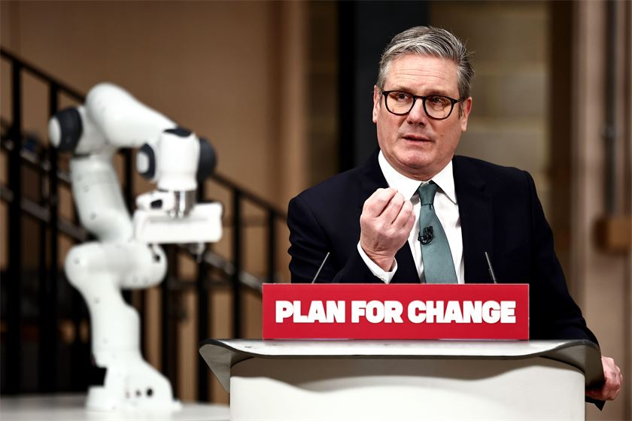
Government policy
The UK has the third largest AI sector in the world after the US and China.
https://www.gov.uk/government/publications/ai-opportunities-action-plan/ai-opportunities-action-plan
https://www.civilserviceworld.com/professions/article/a-restless-and-relentless-government-starmer-sets-out-ai-plan

Slide 26
Areas of disquiet
Whose voice?
Public trust
Impact on jobs

Slide 27
Whose voice
How do you feel about the need to programme the response of self-driving cars in the following scenarios …
1)A deer is in the road, should the car swerve to avoid the deer and risk crashing into a tree?
2)A child runs into the road, should the car swerve to avoid the child and risk hitting an elderly pedestrian?

Slide 28
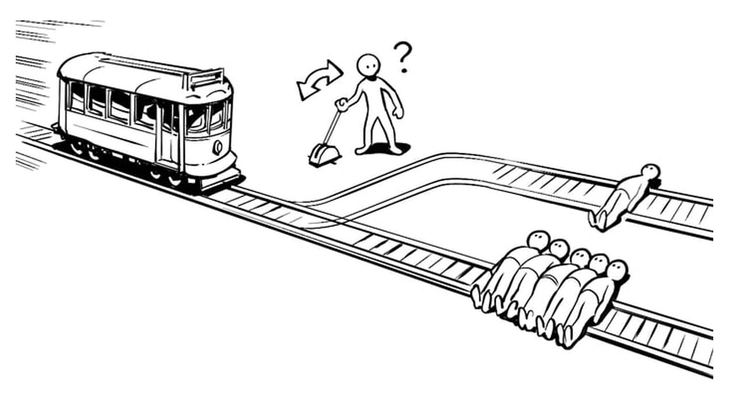
Trolley problem

Slide 29
Public trust
“AI systems have been shown to have a high degree of accuracy in the detection of abnormality on radiographic images, however clinical utilisation is incomplete due to the lack of transparency in how the system makes decisions resulting in trust issues between users and the system.”
Rainey C, Bond R, McConnell J, Gill A, Hughes C, Kumar D, McFadden S. The impact of AI feedback on the accuracy of diagnosis, decision switching and trust in radiography. PLoS One. 2025 May 9;20(5):e0322051. doi: 10.1371/journal.pone.0322051.

Slide 30
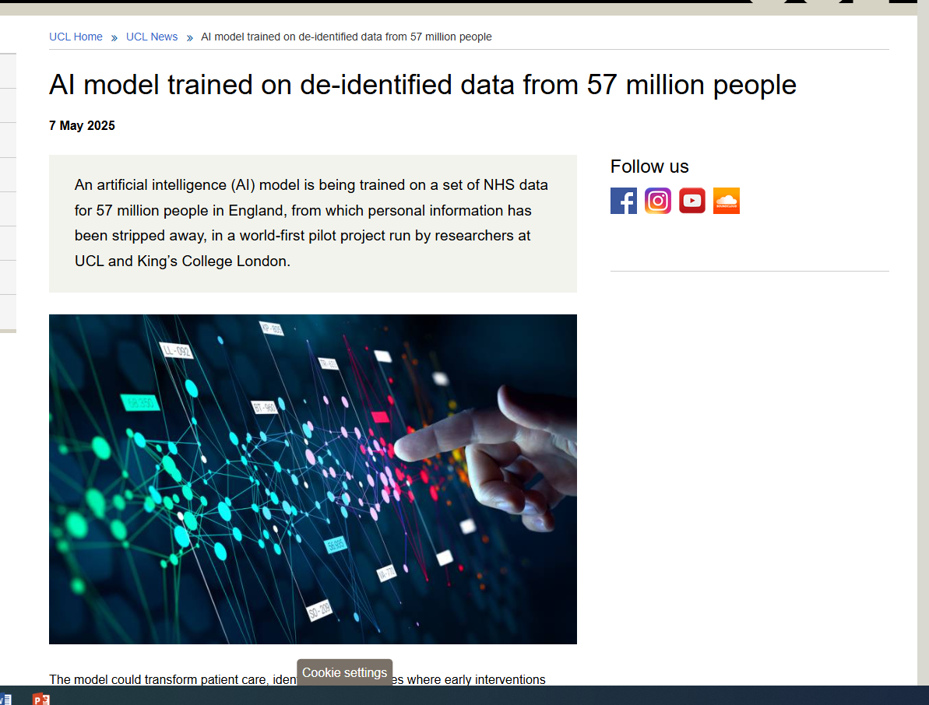

Slide 31
Impact on jobs
“…Corporations including Klarna, UPS, Duolingo, Intuit and Cisco are replacing laid-off workers with AI and automation. While these technologies enhance productivity, they raise serious concerns about future job security. For many workers, there is a big concern over whether or not their jobs will be impacted…”
“It’s Time To Get Concerned As More Companies Replace Workers With AI”
https://www.forbes.com/sites/jackkelly/2025/05/04/its-time-to-get-concerned-klarna-ups-duolingo-cisco-and-many-other-companies-are-replacing-workers-with-ai/

Slide 32
Duolingo aka ‘birdbrain’
Until now, every single exercise chosen by Birdbrain was written, reviewed, edited, and translated by human experts…
Today, we’ve moved into using AI to create these exercises…
but it still needs a lot of help from us humans—in fact, we’re constantly adjusting the instructions we give the model.
https://blog.duolingo.com/large-language-model-duolingo-lessons/

Slide 33
June 22 2023 720 employees
Dec 2024 830 employees
But from teachers to AI wranglers?
How do you support staff/ help them plan their careers?
https://stockanalysis.com/stocks/duol/employees/)

Slide 34
LOCAL/ University policies
Our principled approach
4. Staff using Generative AI in their work must ensure that they comply with our Information Security Policy and IT Acceptable Use Policy and follow the principles below:
Integrity: Generative AI tools must be used in a way that aligns with University ethical principles and values of equality, diversity, and inclusion.
Judgement and Accountability: Staff are accountable for decisions made with the assistance of Generative AI. Generative AI should augment not replace human judgement. Generative AI is known to “hallucinate”, which means that a Generative AI system can generate content that is not grounded in reality. Generative AI can make mistakes and create bias. Always double-check and use your own judgement as to the accuracy and potential bias of the data.
Transparency: The University should be transparent about its use of Generative AI. Where Generative AI is used to support decision making, users must clearly state how. For example, when Generative AI is used to produce meeting notes, they should be checked by the Chair/organiser of the meeting and attendees must be made aware of the use of Generative AI. Further guidance is available here.
Governance: Generative AI usage by staff must comply with our Information Security Policy and all relevant legal requirements.

Slide 35
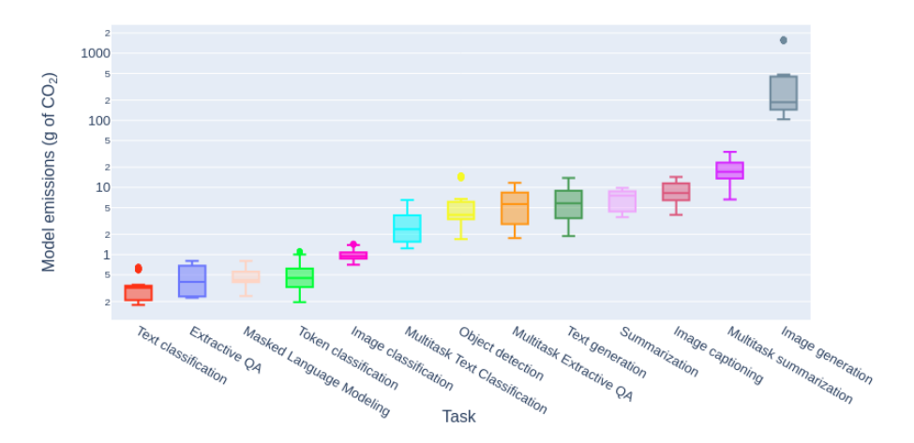
No mention of
Policy towards jobs
Policy towards resource use
Would you be clear on dealing with bias etc
This may be all the guidance users are getting from home institutions
Other guidance is very focused on plagiarism and academic offences
What training is available?

Slide 36
What we’ve talked about
What is it?
  Types of AI
  What is Gen AI
  Examples of programs
The good
  Timesavers
The Bad
  Challenges: bias, unreality,
The ugly
  Governance issues:
    Assessing risk
    National policy
    Impact on jobs
    Local/ employer policy and training

Slide 37
Useful/ interesting reading
Nature’s daily briefing often has interesting news articles https://www.nature.com/briefing/signup
Prompt Engineering for ChatGPT | Coursera (free option)
Adalovelaceinstitute.org (and weekly newsletter)
Turing Institute- particularly AI UK https://www.turing.ac.uk/events/ai-uk-2025
City Lit course https://www.citylit.ac.uk/courses/generative-ai-strategy-and-governance

