Slide 1
ODYSSEY: Optimizing Data Professional Success through Skill Identification, Career Trajectories, and Enhanced Training
Presented by
Lizzie Green Senior Lecturer Economics
Jo Webb
UKDA
Summer 2025

Slide 2
UK Data Services: Some Context
UK data services are experiencing unprecedented growth in demand, meaning that there is a greater need for talent to be managed effectively within the sector.
Yet, there is evidence that people are not being managed strategically within data services. Swan and Brown (2008) highlighted serious challenges in the data services profession, including unclear career paths, limited training (especially in soft skills), and low awareness of data roles as viable careers.
Recent research by Green (2024) shows that many of these problems persist for data service employees; career structures remain underdeveloped and there is a gap in training for soft skills.

Slide 3
ODYSSEY Project
A collaborative project with data services aimed at developing:
A skills framework which maps the jobs roles at different levels to the training and expertise they require
A curriculum for data service managers to see what their current staff skill set is, and where they may need to invest in training and development to ensure sufficient capacity to cover activities, as well as giving career progression opportunities to staff
Guidance for HR processes can use these frameworks for job recruitment and advertising, induction, and career planning
A network of engaged professionals in data services to provide a forum for discussion s and sense-check within the project, and a basis for continuing development of ideas post-project
A website to host templates and materials

Slide 4
The misalignment of competency frameworks
Many data services organisations have introduced competency frameworks as a way of standardising the skillset required of data professionals.
Whilst these frameworks can help provide an overview of the technical competencies involved in the role, there exists a notable misalignment between these frameworks and the practical realities of recruitment and retention within the industry.
This misalignment is further exacerbated by the frequent omission or undervaluation of essential soft skills, such as communication, adaptability, and problem-solving, which are critical for effective performance but are challenging to quantify.

Slide 5
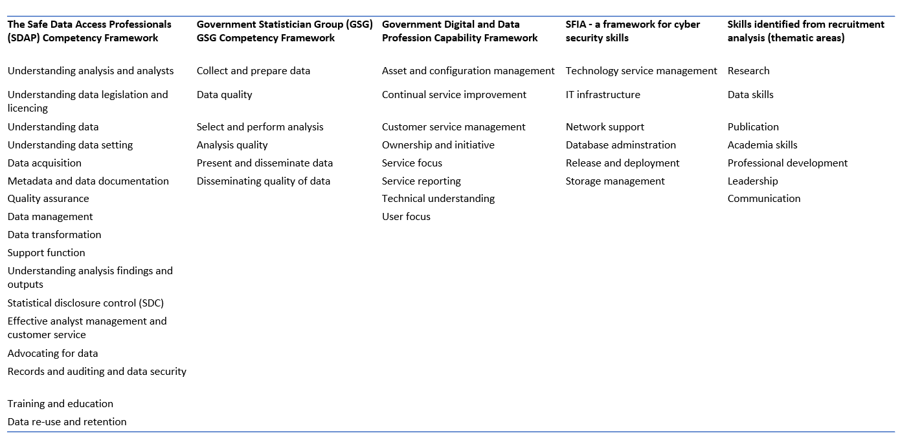
Often treated as administrative staff, data services staff do not fit into the typical progression structures that emphasize managerial growth. In contrast, the FDS analysis of job specifications and recruitment showed that 'research' was the most requested skill, with 'academia' ranking fourth, suggesting a research-focused career structure. The table above compares the current frameworks for data professionals with recruitment analysis findings, highlighting a disconnect between identified core skills and those prioritized by data professionals.

Slide 6
Will this result in better data services?

Slide 7
PROGRESS: Pathways for Roles mapping Opportunities in Data: Growth, Recognition, and Enhanced Skill Sets
This stream of work focuses on developing a skill framework which holistically and realistically captures the different roles, the different skills and areas for development
Provide example career pathways mapped with the skills framework

Slide 8
Entry Level output checker support staff Open Safely | 1 | 2 | 3 | 4 | 5 | 6 | 7 | 8 | Training available
Systems design |  |  |  |  |  |  |  |  | ILM Link
Effective communication |  |  |  |  |  |  |  |  | UKDS Link
Governance |  |  |  |  |  |  |  |  | UWE Link
Risk management |  |  |  |  |  |  |  |  | UWE Link
Information management |  |  |  |  |  |  |  |  | MRC Link
Customer Service Management |  |  |  |  |  |  |  |  | ILM Link
Audit |  |  |  |  |  |  |  |  | UWE Link
Quality management |  |  |  |  |  |  |  |  | UKDS Link
Coding in Python |  |  |  |  |  |  |  |  | UKDS Link

Slide 9
ODYSSEY Project
A collaborative project with data services aimed at developing:
A skills framework which maps the jobs roles at different levels to the training and expertise they require
A curriculum for data service managers to see what their current staff skill set is, and where they may need to invest in training and development to ensure sufficient capacity to cover activities, as well as giving career progression opportunities to staff
Guidance for HR processes can use these frameworks for job recruitment and advertising, induction, and career planning
A network of engaged professionals in data services to provide a forum for discussion s and sense-check within the project, and a basis for continuing development of ideas post-project
A website to host templates and materials

Slide 10
Impact on EDI
The prioritization of “hard” skills over “soft” skills within these competency frameworks has a spillover effect on recruitment and selection for data services staff.
The impact of this can be seen in a plethora of ways, including how it affects equality, diversity, and inclusion (EDI).
Increasing emphasis has been placed on embedding EDI into workforce practices across public sector data infrastructures. However, the language used in job advertisements, based on these competency frameworks, may unintentionally undermine these goals.

Slide 11
ESRC Future Data Services (FDS) strategic review
The research outlined in this presentation is part of the wider Future Data Services (FDS) project, which aims to optimize data professional success by identifying skills, career trajectories, and training requirements for enhanced data service delivery.
It feeds into the (current) ODYSSEY (Optimizing Data Professional Success: Identifying Skills, Career Trajectories, and Training Requirements for Enhanced Data Service Delivery) project which has developed toolkits to support data services with onboarding, career pathways and individual development and learning.
300 UK job advertisements were analysed for data-related roles to examine patterns in recruitment language, pay, and job location and to look for instances where recruitment language could comprise EDI in data services.

Slide 12
Pertinent literature
Gaucher et al. (2011) developed a lexical framework to identify gendered language in job advertisements, revealing that masculine-coded terms like “leader”, “competitive,” and “dominant” are more common in male-dominated fields and can discourage women from applying by reducing their sense of belonging.
Feminine coded words such as “support” and “interpersonal” were less frequently used in these fields. Gaucher et al. (2011) emphasized the importance of gender-neutral language to promote equality and attract diverse candidates.
Subsequent research supports this, showing that job advertisement wording can reinforce or challenge gender and racial inequalities. Arceo-Gomez et al. (2022) linked gendered language to salary disparities, contributing to the broader literature on persistent gender pay gaps.
In the context of data services, Thielen and Neeser (2019, 2022) and Tokarz and Mesfin (2021) highlighted the need for more inclusive recruitment. They noted the prevalence of gendered language in library job ads and observed a shift toward hiring data professionals from outside traditional librarian backgrounds, potentially broadening the talent pool.

Slide 13
Methodology
This study analysed a sample of 300 job advertisements for data-related roles across the UK public sector, with a focus on salary, gendered language, and regional distribution.
Using Gaucher et al.'s (2011) lexical framework, the presence of gender-coded language was identified and its relationship with salary and regional distribution was assessed.
Job advertisements were obtained from Indeed.com in January 2024, focusing on public sector roles supporting research, policy, or operational data use.
The analysis included both job descriptions and person specifications to gain a comprehensive understanding of expectations and requirements.
NVivo was used for coding gendered language, and Stata was used for regression analysis.

Slide 14
Findings 1
The average advertised salary was £40,976 (SD = £13,397), with a range spanning from £21,149 to £109,307.
The substantial variation reflects the inclusion of a wide spectrum of roles, from early-career support positions to senior and specialist roles in data management and analysis.
Job adverts contained, on average, 18.8 feminine-coded words (SD = 9.10) and 17.3 masculine-coded words (SD = 10.33).
In terms of overall coding style, 62.3% of adverts were classified as feminine-coded, while 37.7% were masculine-coded, based on the dominant proportion of gendered words.

Slide 15
Findings 2
A clear pattern emerges: feminine-coded adverts dominate lower salary bands, particularly between £20,000–£70,000. For example, in the £20,000–£30,000 range, over 70% of adverts are feminine-coded, and this trend holds relatively steady through the £60,000–£70,000 range.
In contrast, masculine-coded adverts become increasingly prevalent at higher salary levels.
Notably, in salary bands above £80,000, the proportion of masculine-coded adverts sharply increases. By the £90,000–£110,000 bands, all adverts are exclusively masculine-coded.

Slide 16
Findings 3
We regressed logPay on the proportion of feminine-coded and masculine-coded words within the job advert. Results indicated that feminine-coded language was significantly negatively associated with salary (β = −15.19, p = 0.030).
In practical terms, this suggests that a one-unit increase in feminine word coverage—equivalent to a 0.01 (or 1%) increase in the proportion of feminine-coded words—was associated with an approximate 14.1% reduction in advertised salary when back-transformed from the log scale.
Across all models, the negative association between feminine-coded language and salary persisted—even when accounting for job location.
This suggests that adverts framed with more communal, empathetic, or inclusive language may be associated with lower salary offers, either because they correspond to lower-valued roles or due to broader perceptions about such roles within institutional hierarchies.

Slide 17
Implications of the findings
The findings raise concerns about how seemingly subtle linguistic choices may reinforce pay disparities and hinder inclusive hiring in the data services workforce.
Feminine-coded language may signal lower-status, supportive roles, affecting pay. Language in job adverts can unintentionally reinforce gender pay gaps.
The study calls for gender-neutral, inclusive language to support EDI and fair recruitment in data services.
Revisiting how roles are framed, especially in terms of linguistic tone, could help align inclusive values with equitable outcomes.
Given the importance of data services to evidence-based policy, it is critical that the sector not only recruits diversely but also avoids perpetuating pay disparities through the language of its recruitment materials.
The FDS (of which ODYSSEY forms part) project seeks to address these issues by developing, testing and evaluating solutions to data service challenges.

Slide 18
Development of HR tools for data services
EDI Factsheet for Line Managers.docx
Conflict and offboarding/
Employee Exit Checklist
Gardening Leave Factsheet
Managing conflict
Off boarding
Onboarding
Inclusivity in onboarding checklist
Onboarding factsheet
Induction checklist
Mentor and support guidance
Performance Management
Managing Performance UK Data Services Factsheet
Personal Development Plan Factsheet
Personal Development Plan Template
Personal Development Plan feedback form 360 example
Personal Development Plan Form
Recruitment
Data Analyst Interview Question Sheet
Inclusive Recruitment Toolkit
Recruitment and Selection
Employee Voice Factsheet
Line Manager Duties Factsheet
Organisational Culture Factsheet for Line Managers

Slide 19
Next stages
A collaborative project with data services aimed at developing:
A skills framework which maps the jobs roles at different levels to the training and expertise they require
A curriculum for data service managers to see what their current staff skill set is, and where they may need to invest in training and development to ensure sufficient capacity to cover activities, as well as giving career progression opportunities to staff
Guidance for HR processes can use these frameworks for job recruitment and advertising, induction, and career planning
A network of engaged professionals in data services to provide a forum for discussions and sense-check within the project, and a basis for continuing development of ideas post-project
A website to host templates and materials

Slide 20
References
Arceo-Gomez, E. O., Campos-Vazquez, R. M., Badillo, R. Y., & Lopez-Araiza, S. (2022). Gender stereotypes in job advertisements: What do they imply for the gender salary gap?. Journal of Labor Research, 43(1), 65-102.
Gaucher, D., Friesen, J., & Kay, A. C. (2011). Evidence that gendered wording in job advertisements exists and sustains gender inequality. Journal of personality and social psychology, 101(1), 109.
Green, E. (2024). Services, people and skills: Final report for Future Data Services. University of the West of England. https://uwe-repository.worktribe.com/output/13403298/services-people-and-skills-final-report-for-future-data-services
Swan, A., & Brown, S. (2008). The skills, role and career structure of data scientists and curators: An assessment of current practice and future needs. Available from https://eprints.soton.ac.uk/266675/ Accessed 30.4.25.
Thielen, J., & Neeser, A. (2019). How you can write more inclusive data practitioner job postings. Journal of eScience Librarianship, 8(2).
Tokarz, R. E., & Mesfin, T. (2021). Stereotyping ourselves: gendered language use in management and instruction library job advertisements. Journal of Library Administration, 61(3), 301-311.

