Slide 1
Researcher Online System for Applications (ROSA)
Presentation to
Secure Data Access Professionals

Slide 2
Introduction
The Researcher Coordination Unit (RCU) is responsible for the stewardship of RMF data and the application of the “five safes”:
Safe Researchers,
Safe Settings,
Safe Projects,
Safe Data, and
Safe Outputs.

Slide 3
Introduction
RCU manages the safe access to RMFs using the controls available to us through Microsoft Azure multi-factor authentication, Citrix Virtual Desktop and our in-house developed Researcher Online System for Applications (ROSA).

Slide 4
Research Data Portal (RDP)
The Research Data Portal is a Citrix virtual desktop designed to provide secure access for approved researchers to access approved RMF datasets and work with them using a selection of statistical applications such as Stata, R/Rstudio, LibreOffice, ArcGIS and SPSS, depending on requirements.
Access to the project folders and RMFs is controlled via the Researcher Online System for Applications (ROSA).

Slide 5
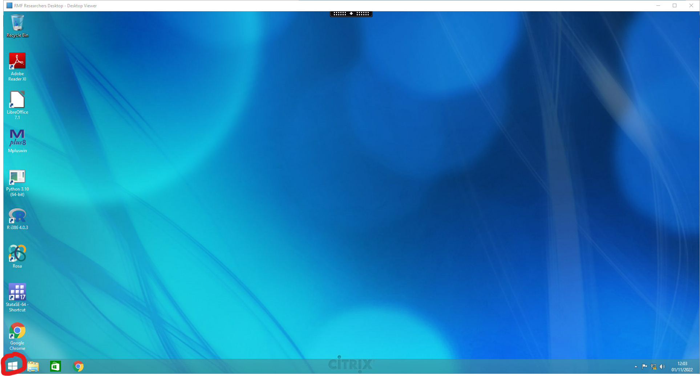
Research Data Portal (RDP)
Researcher View

Slide 6
Researcher Online System for Applications (ROSA)
ROSA, developed in-house by RCU and CSO IT and launched in November 2022, manages:
research organisation and researcher registration and approval,
RMF project applications and approval,
user onboarding,
delivery of RMF datasets,
project folder access control,
output requests and approval,
project expiry and withdrawal of access.

Slide 7
Research Organisation Registration
The very start of the workflow within ROSA is the Research Organisation Registration. RCU, through ROSA, sends an invitation to the Senior Representative of an organisation to register with the CSO as a Research Organisation, nominating delegates to the role of RMF Contact to approve researcher and project applications on behalf of their organisation.
The Research Organisation registration is managed through an approval workflow in ROSA requiring final approval by the Director General.

Slide 8
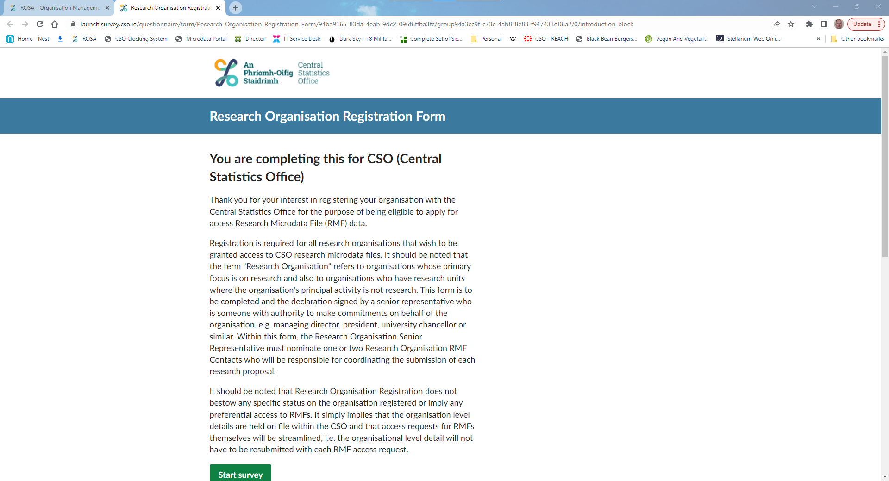
Research Organisation Registration
Senior Representative View

Slide 9
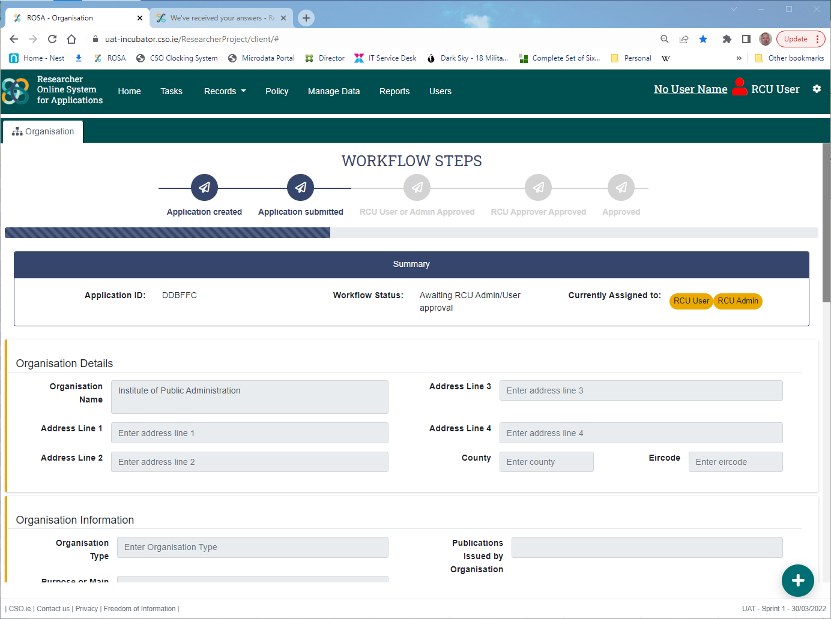
Research Organisation Registration
Approver View

Slide 10
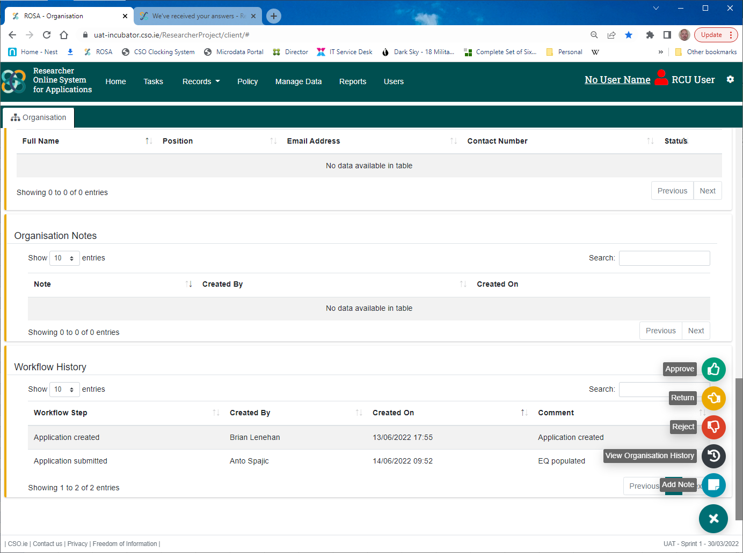
Research Organisation Registration
Approver View

Slide 11
Researcher Registration
Once the Research Organisation has been approved, ROSA creates Active Directory (AD) profiles for the RMF Contacts and sends them instructions to log in and use the system. They can now log in and create new researchers within ROSA.
ROSA will create an AD profile for the researcher and send them instructions to log in and complete their Researcher Registration application within ROSA. As part of this registration, they must provide a detailed account of their previous research experience and previous use of the provided statistical applications and they must watch a number of mandatory RMF training videos and successfully answer multiple-choice questions that follow. Once submitted, their application follows an approval workflow that ends in their approval, or otherwise, by the Director General. Once approved, they can now create RMF project applications.

Slide 12
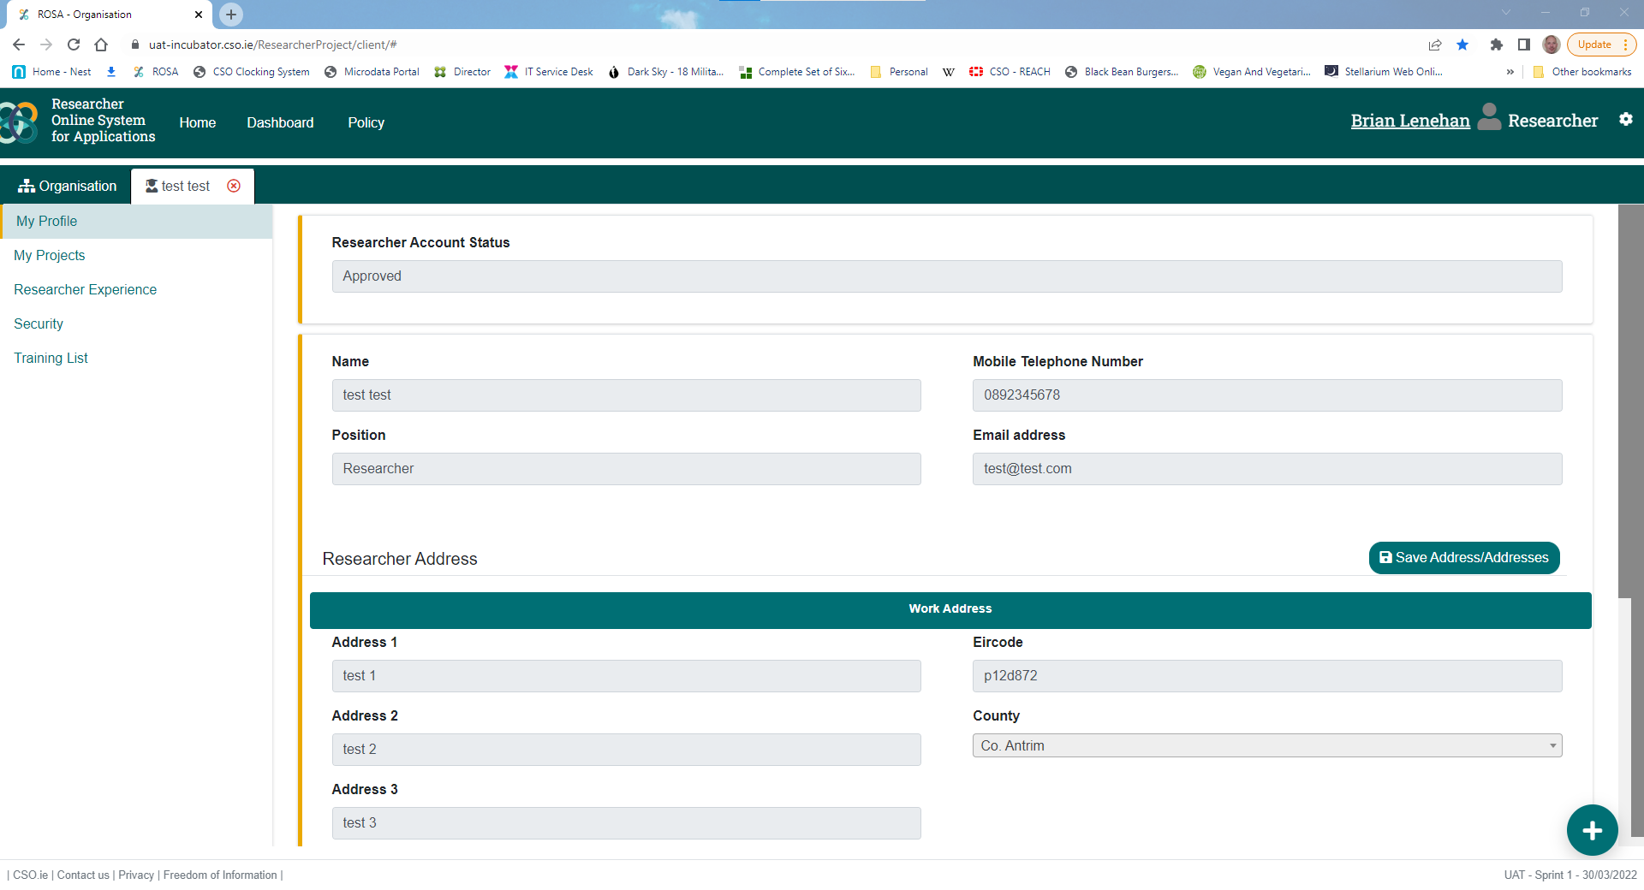
Researcher Registration
Researcher View

Slide 13
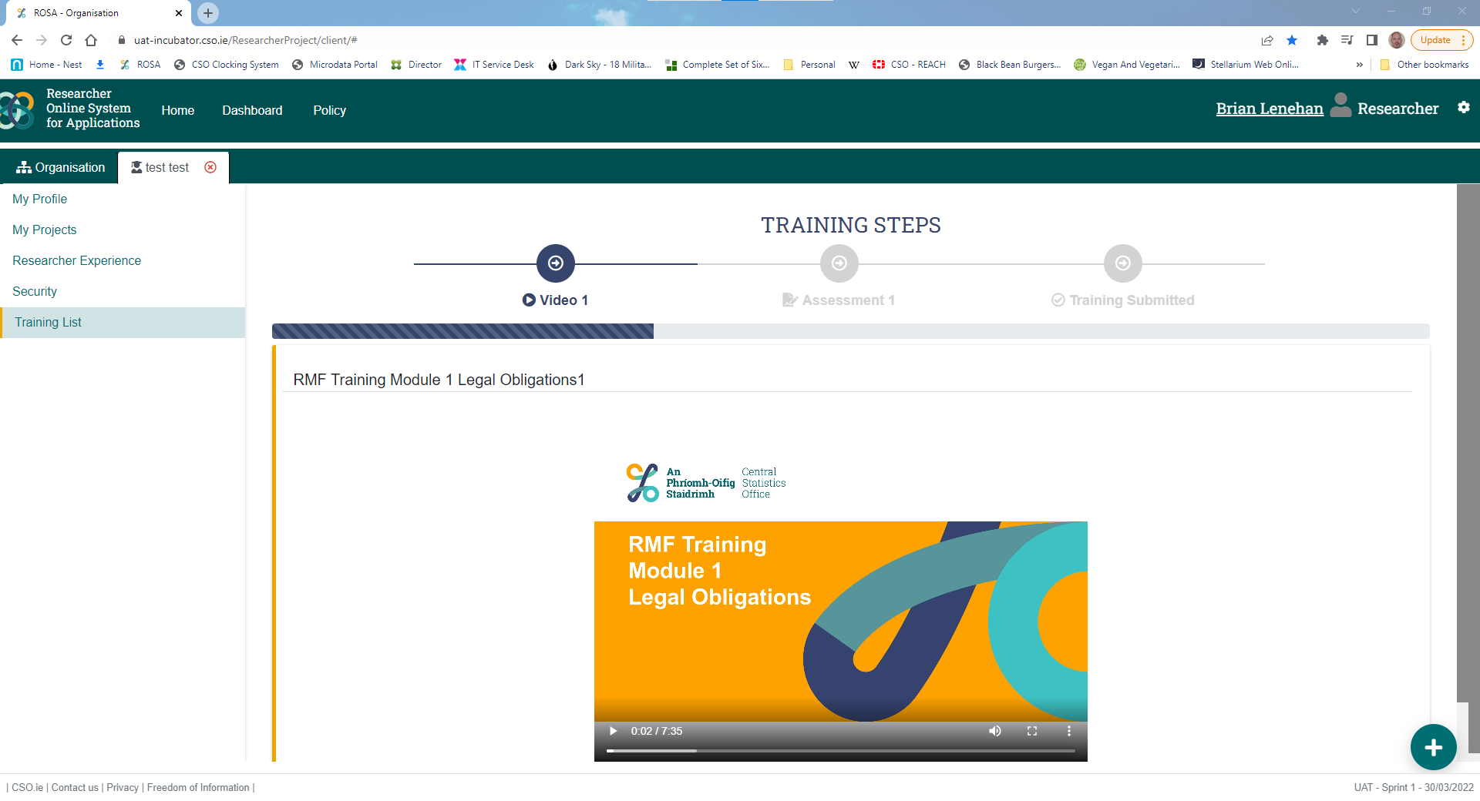
Researcher Registration
Researcher View

Slide 14
RMF Project Application
A registered Researcher can create a project application within ROSA by completing an online form, selecting other registered researchers to be included in the project, and selecting the required RMF datasets from a catalogue. Once submitted, the application follows an approval workflow within ROSA that will route it to the Data Custodians responsible for the selected datasets, and onward ultimately to the Director General to sign-off.

Slide 15
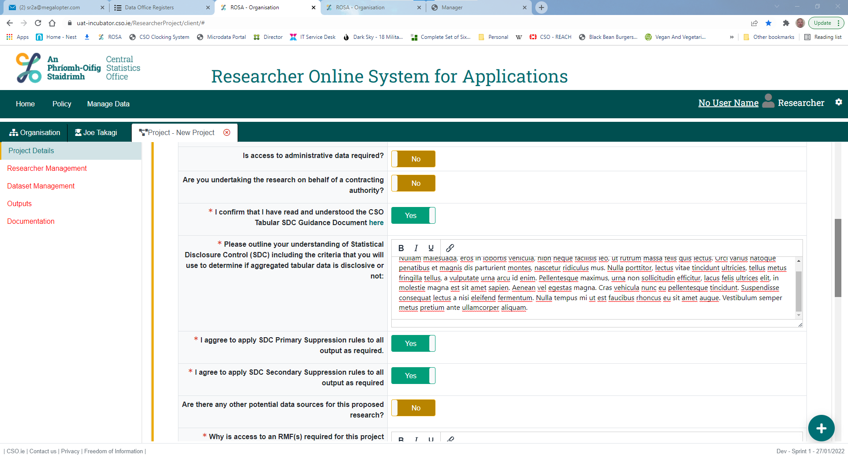
RMF Project Application
Researcher View

Slide 16
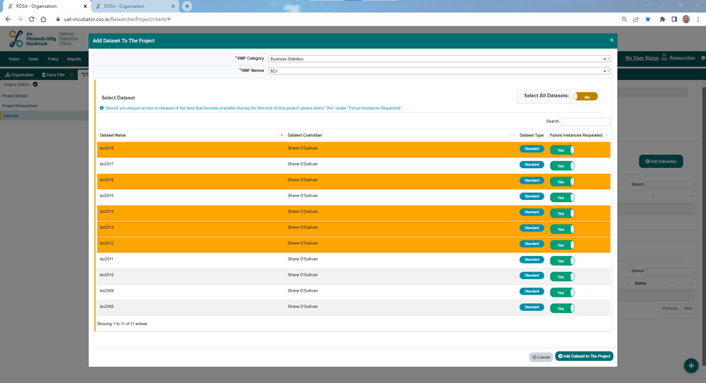
RMF Project Application
Researcher View

Slide 17
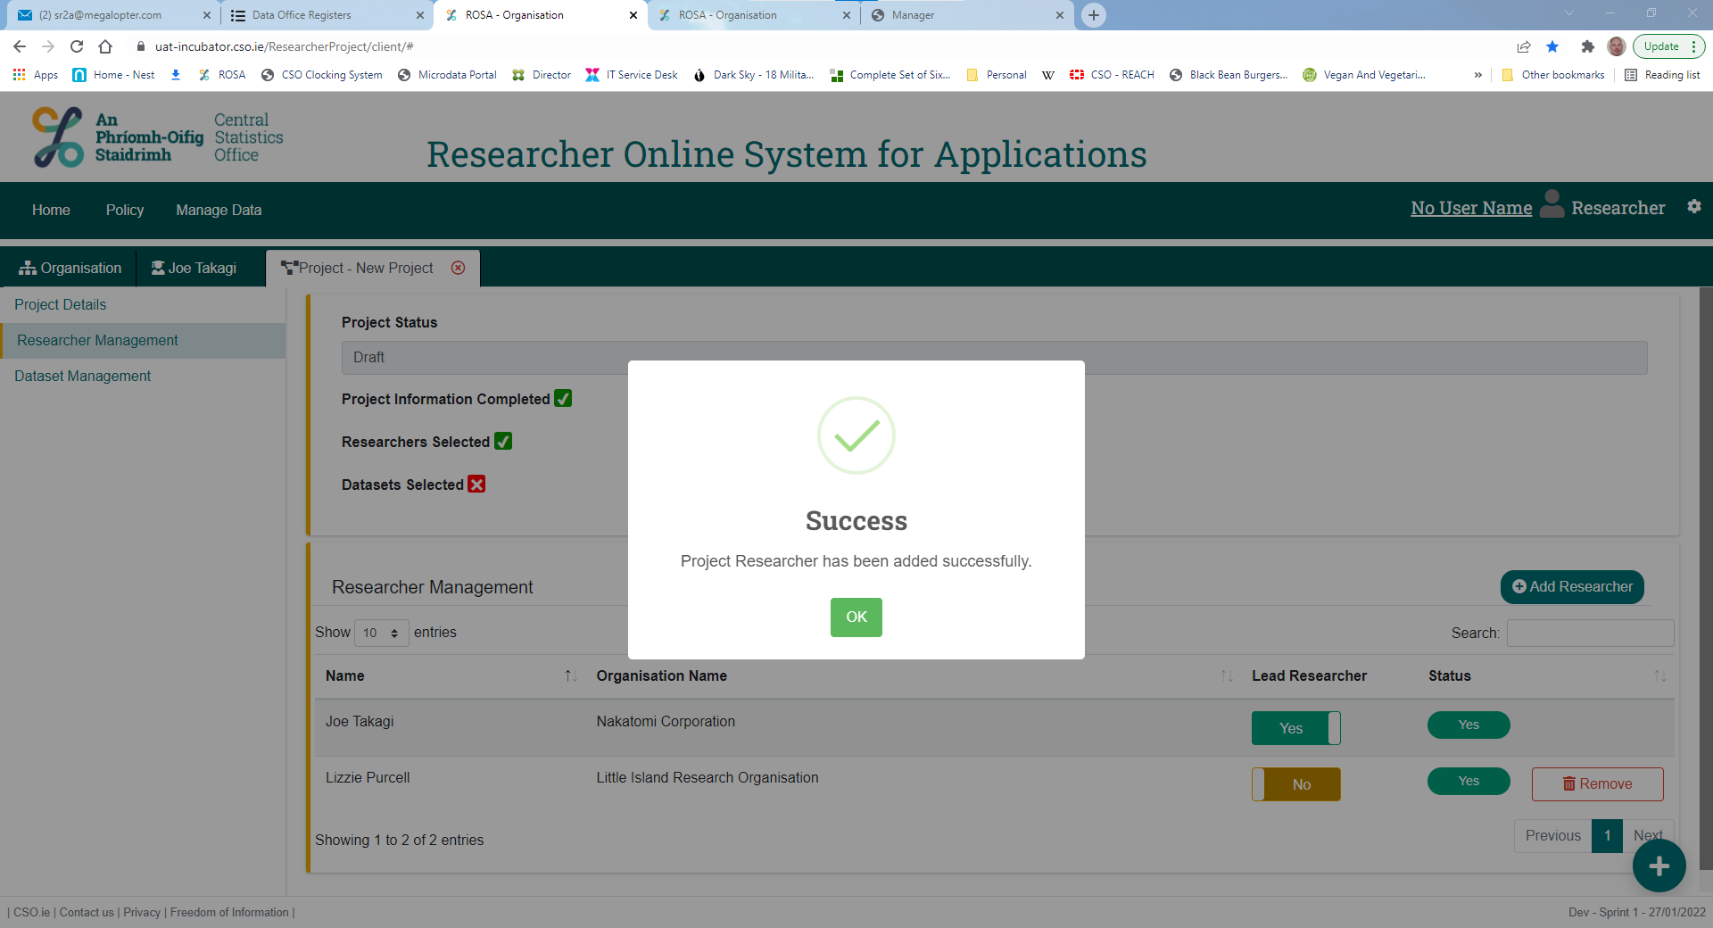
RMF Project Application
Researcher View

Slide 18
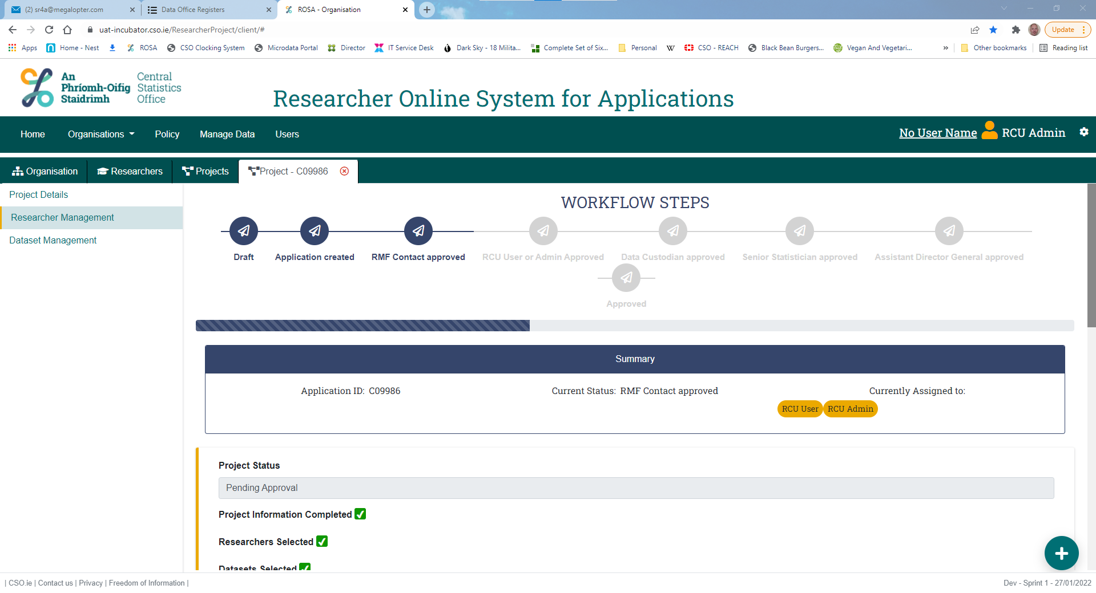
RMF Project Application
Approver View

Slide 19
Delivery of RMFs and RMF Project Folder Access Control
Once an RMF project application has been approved and the Researchers have accepted the Standard Agreement and Declaration of Secrecy, required so that they can be appointed as Officers of Statistics, ROSA will create a unique project folder for their project and pull down the approved datasets from the Data Hub into their project folder.
Researchers can only access one project folder at any one time, by setting that project to “live” within ROSA. This ensures that files cannot be transferred from one project folder to another.

Slide 20
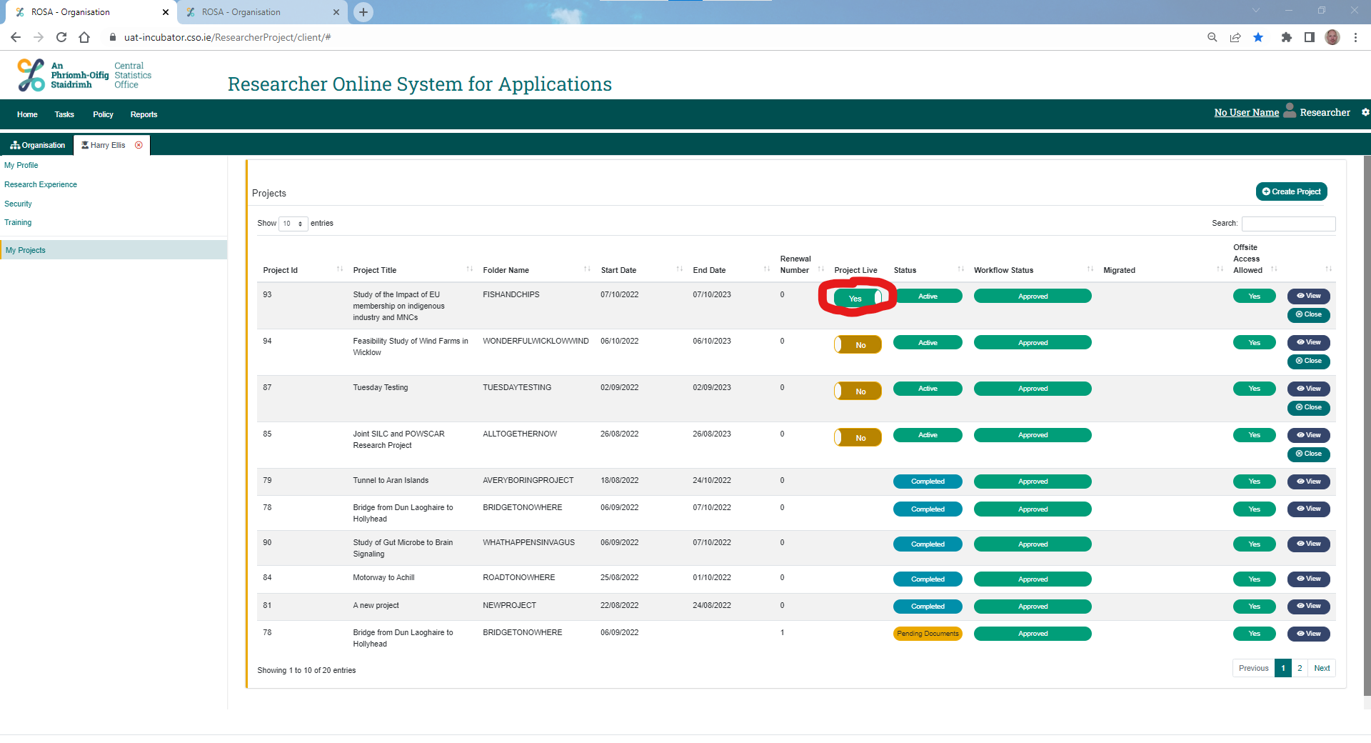
Delivery of RMFs and RMF Project Folder Access Control
Researcher View

Slide 21
Output Requests and Approval
When a Researcher wants to retrieve outputs from their work on the dataset files, they can create an Output Request within ROSA, providing a description of their output and providing details as to what Statistical Disclosure Control measures were applied. They will then drag and drop those files into the Output Request form and submit it for approval.
ROSA routes the request along an approval workflow to the Data Custodian(s) associated with the datasets used in the project for their consideration. If approved, the files are immediately emailed from ROSA to the researcher.
ROSA retains a copy of each approved output file within the project record.

Slide 22
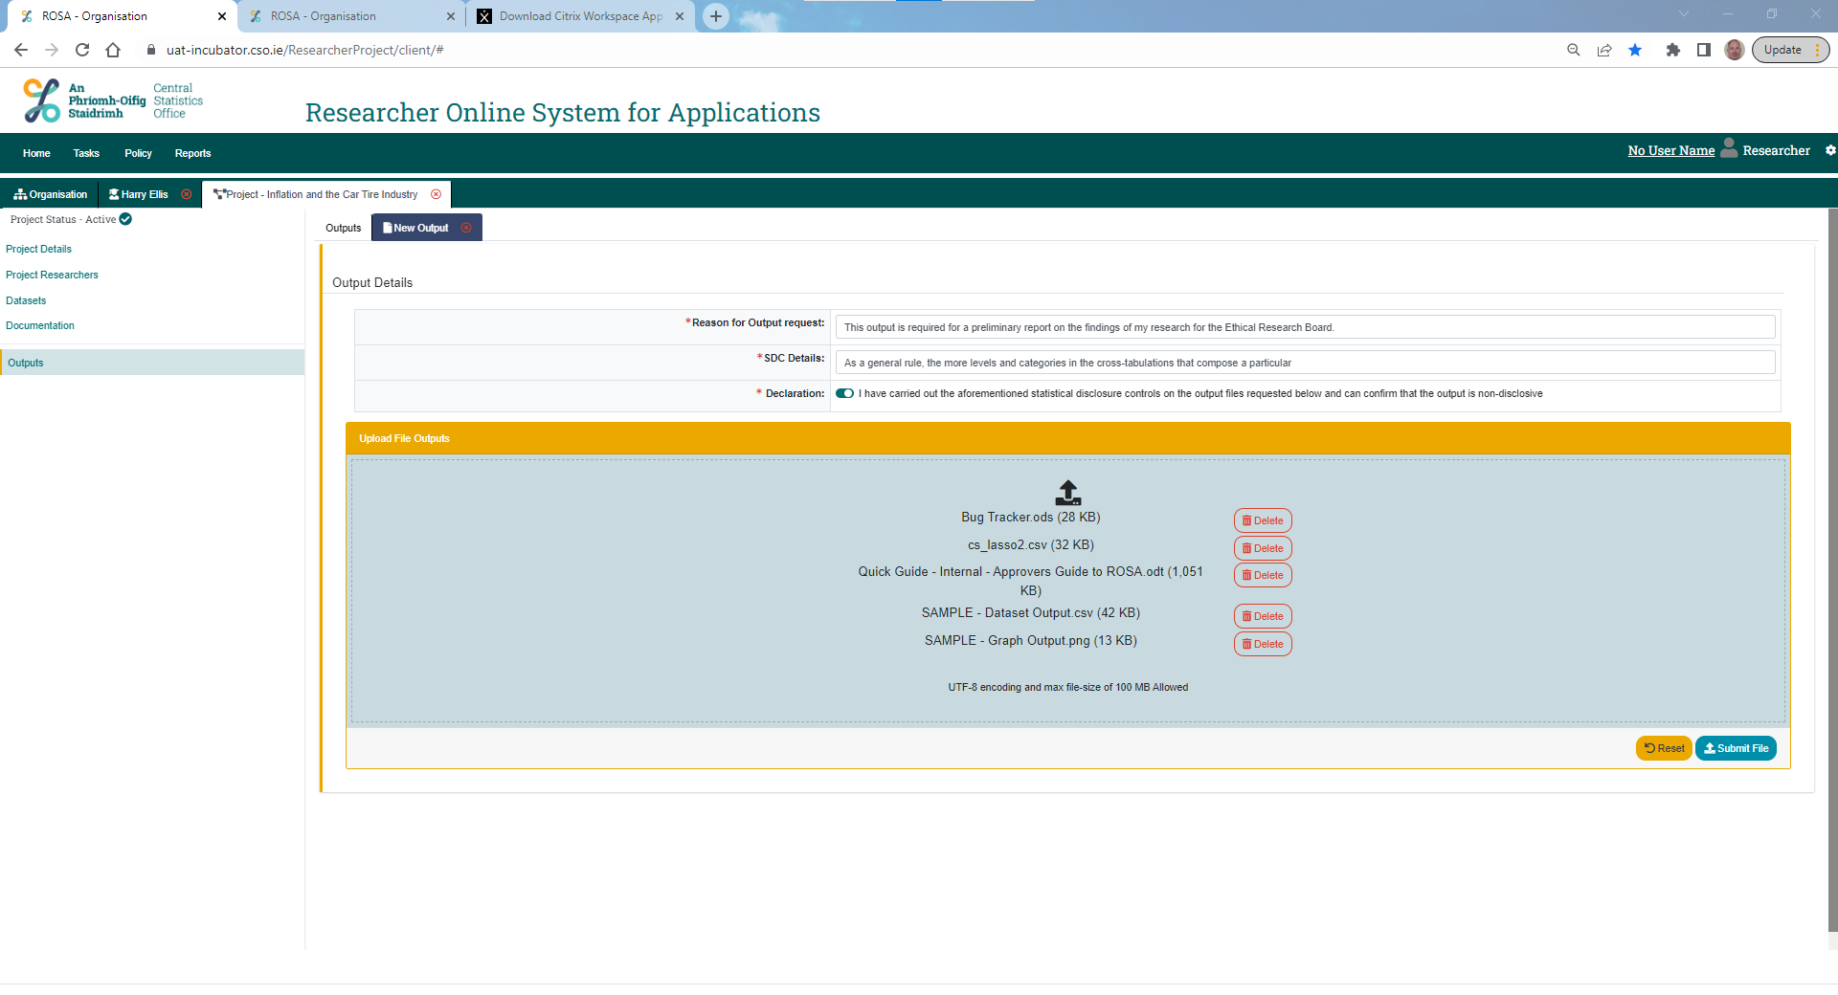
Output Requests and Approval
Researcher View

Slide 23
Project Expiry or Renewal
On the date of project expiry, ROSA automatically removes researcher permissions to the project folder. They cannot make the project “live”.
Two months prior to expiry, ROSA sends an automated email to the Lead Researcher of the project to notify them of the impending expiry. At this point, should they choose to renew the project, they can now press a “Renew” button beside their project record in ROSA and provide a reason for the renewal.
ROSA will route this project renewal application through the project approval workflow. If approved, the researchers will continue to have access to their previous datasets and working files.

Slide 24
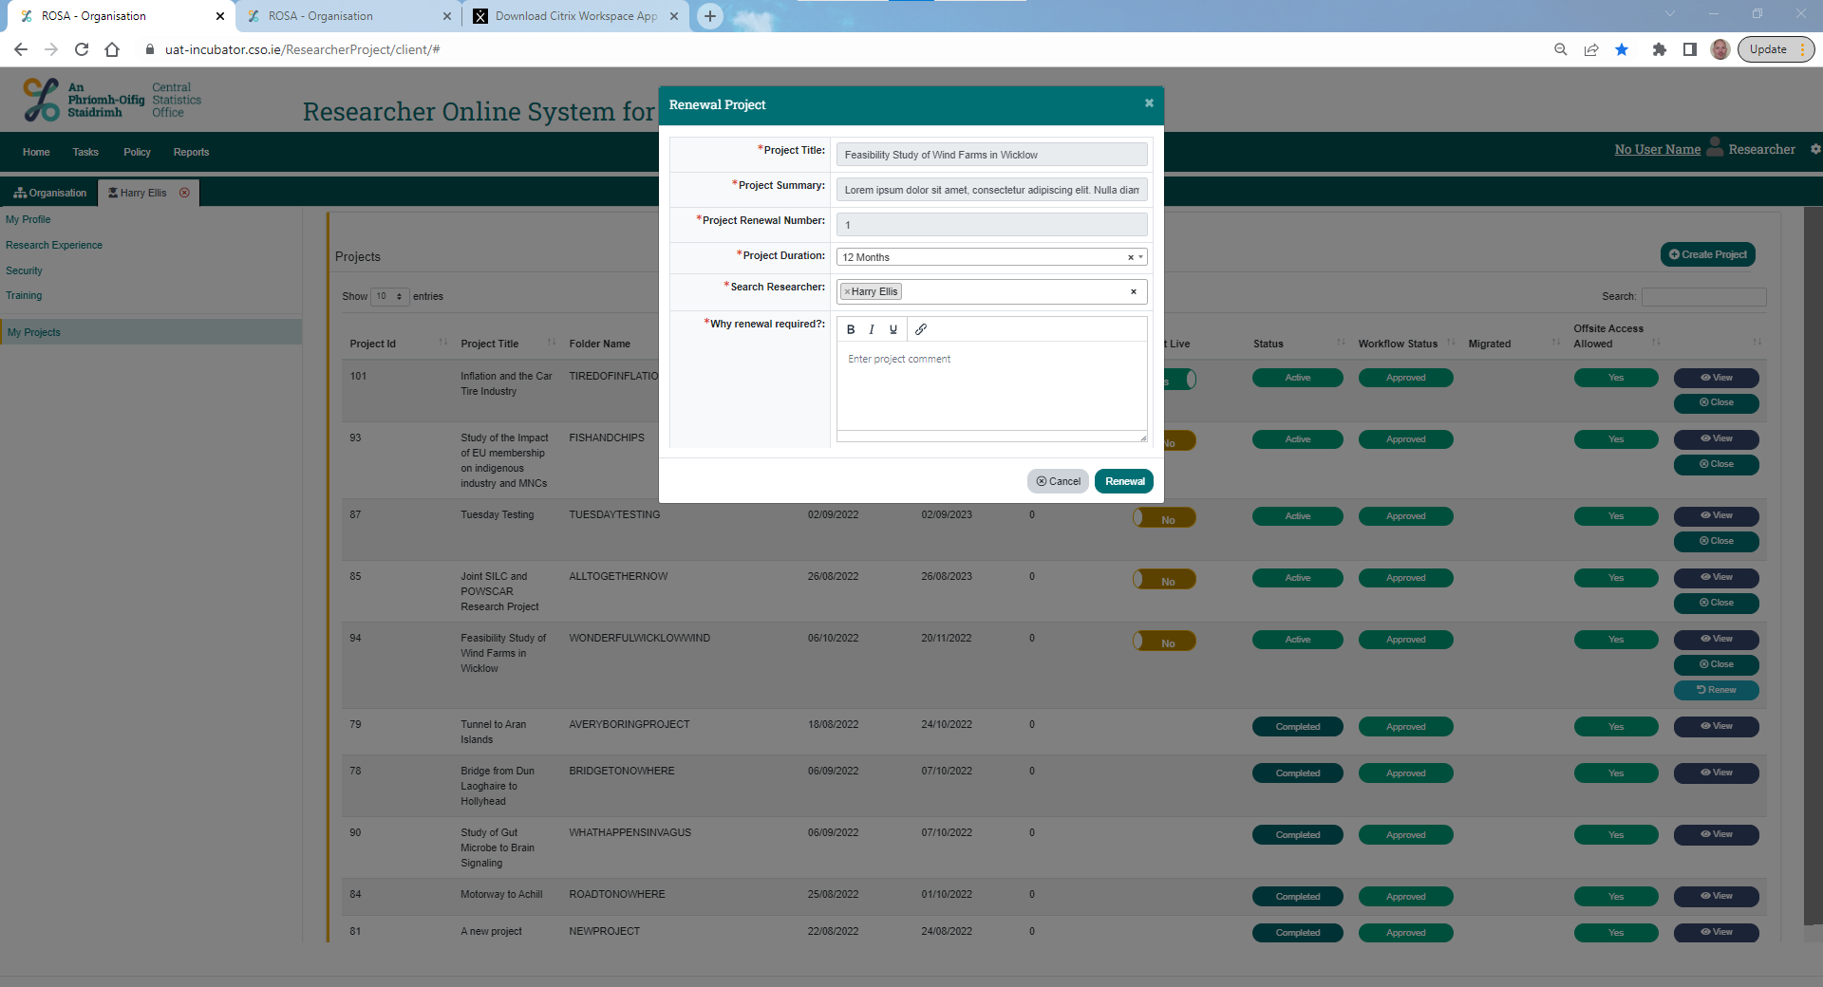
Project Expiry or Renewal
Researcher View

Slide 25
Benefits of ROSA
Efficiency
ROSA automates previously manual, and often complex, tasks and eliminates risk of error in the administration of access to RMF datasets.
The speed by which RMF applications and output requests, especially for single-RMF projects, has increased significantly. Applications that, prior to the launch of ROSA, took up to 4 to 6 weeks to approve are regularly approved within a week or two.
Accuracy
ROSA ensures that the approved Researchers receive the latest version of any RMF dataset into their project folder as soon as it is released.

Slide 26
Benefits of ROSA
Transparency
CSO staff can easily track and monitor the progress of any application within ROSA in real time.
Project records and approved outputs are available to the researcher and to CSO approvers in accordance with the Data Retention Policy. ROSA automatically applies the Data Retention Policy rules to archive records, files, etc.

Slide 27
Contact:
rcu@cso.ie

