Slide 1

Developing TRE infrastructure and best practices for researchers
Photo by Michael Dziedzic on Unsplash
UKDS SDAP
1st December 2022
Ed Chalstrey
Research Data Scientist
echalstrey@turing.ac.uk

Slide 2

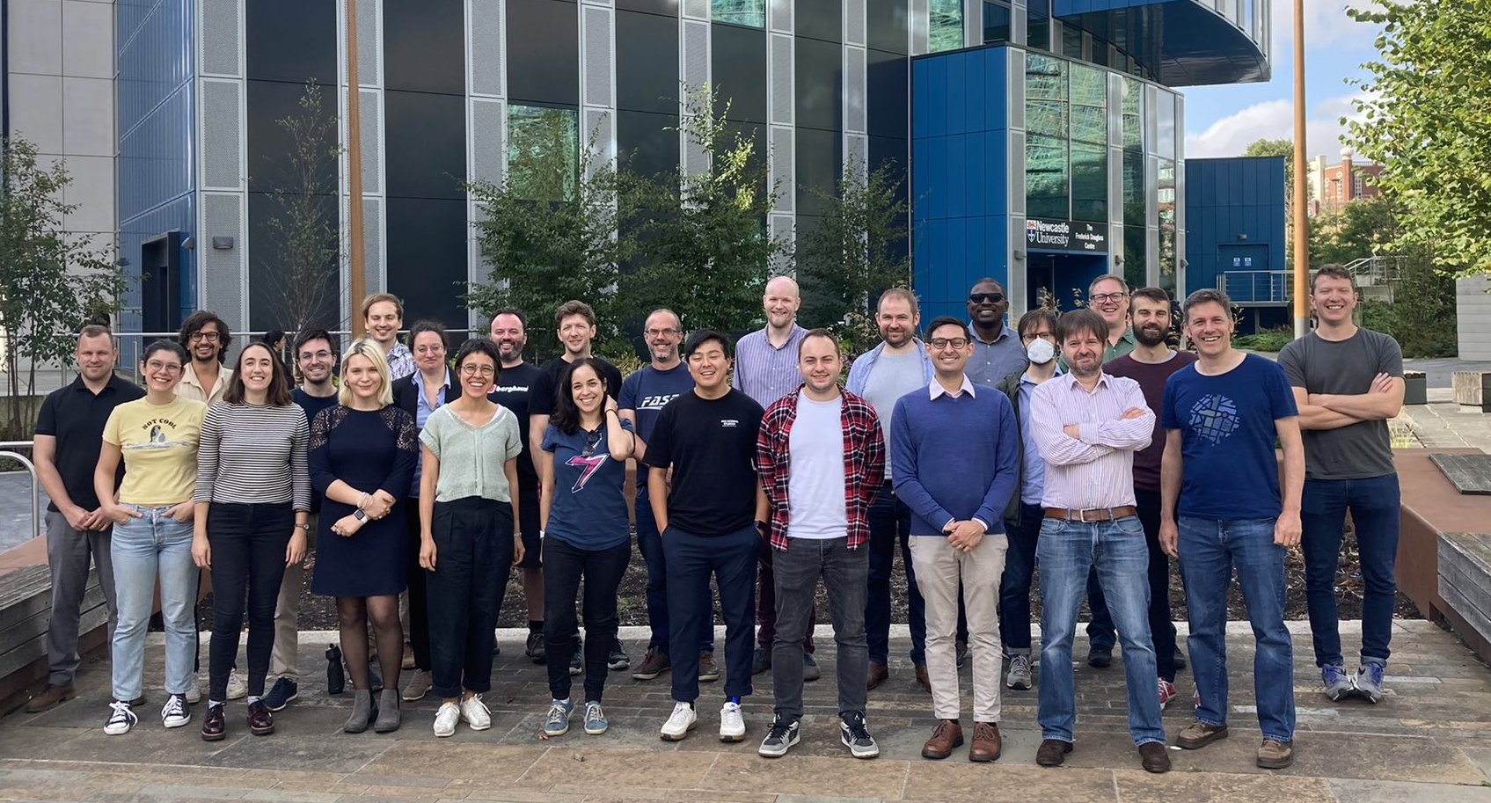
Firstly… who am I?
Ed Chalstrey
Research Data Scientist
Research Engineering Group

Slide 3
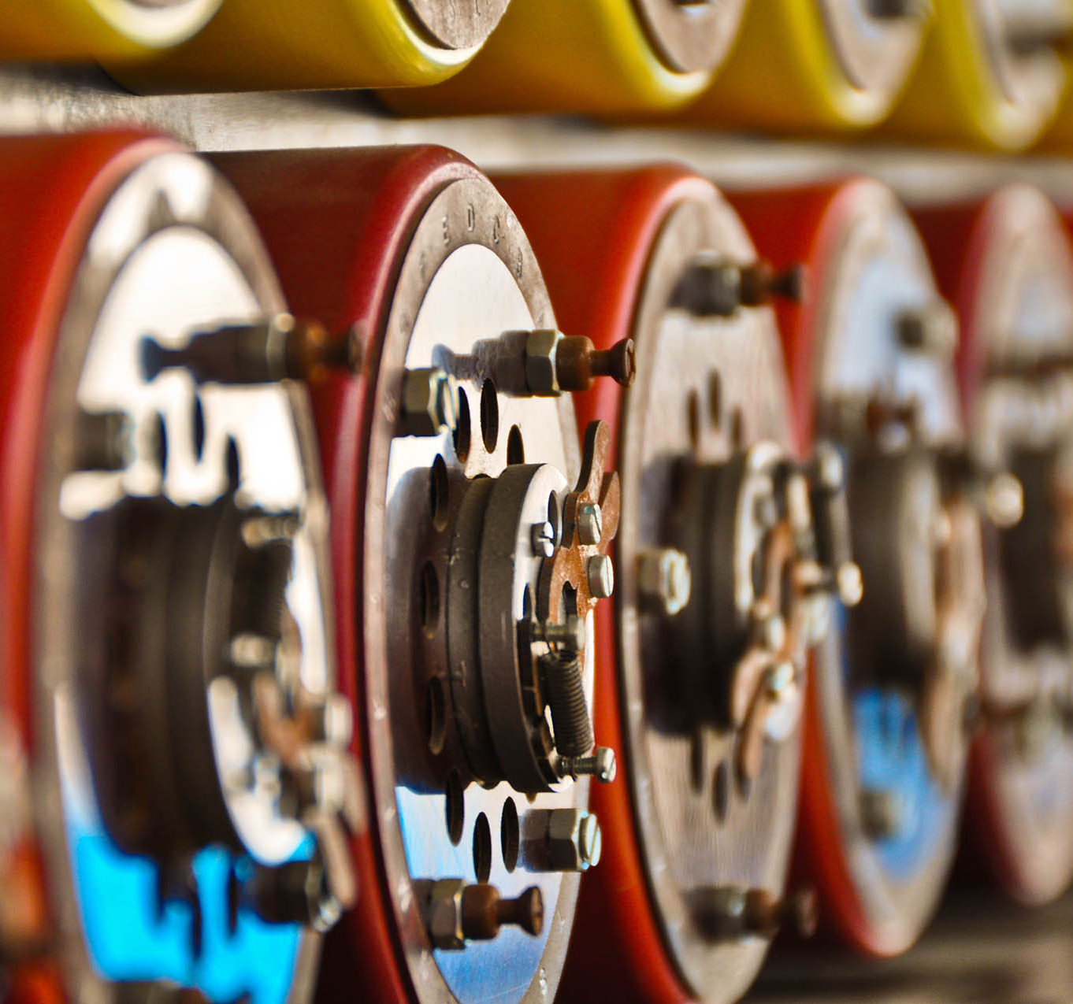
Research Engineering Group
Collaborate across Turing programmes
30+ Research Software Engineers / Data Scientists
Co-investigators on a range of Turing projects
Support wider Turing research community
Bridge research / software divide

Slide 4
Trusted Research Environments (TREs)
TRE projects at The Alan Turing Institute I’m involved in:
Data Safe Haven’s in the Cloud
Developing and Publishing Code for Trusted Research Environments: Best Practices and Ways of Working

Slide 5
Sensitive data?
Typically in the UK, TREs have been used for research with healthcare data, genomics and other data about people that is either personally identifiable, or could be used to identify people via data linkage. Their deployment and usage has grown during the Covid-19 pandemic.
But TREs can in principle be used for any data science projects where restricting access is beneficial.

Slide 6
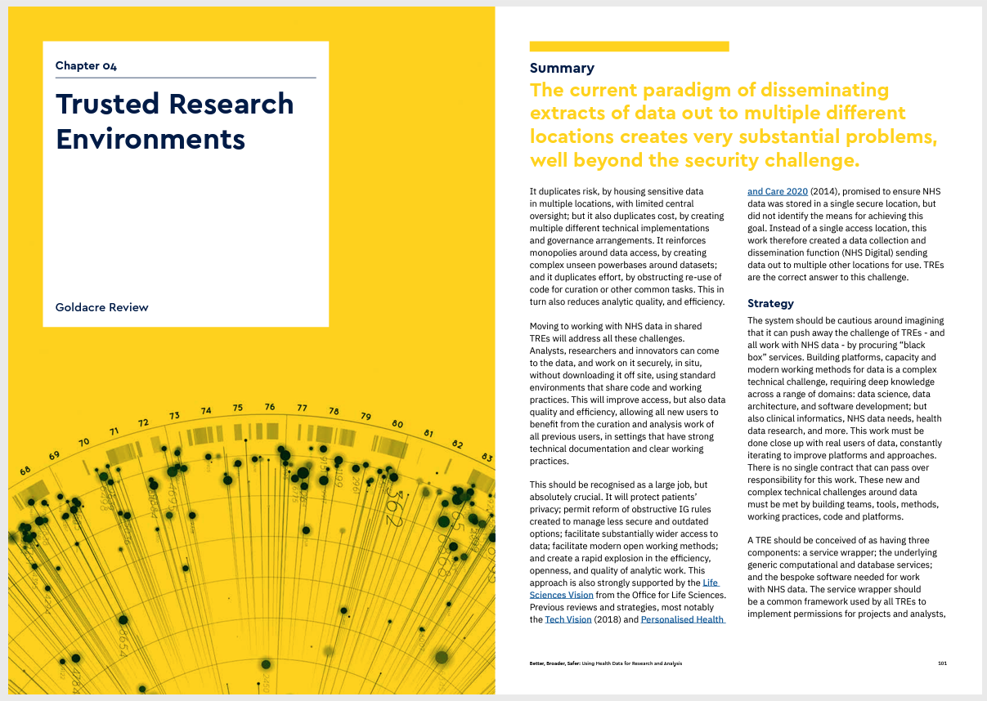
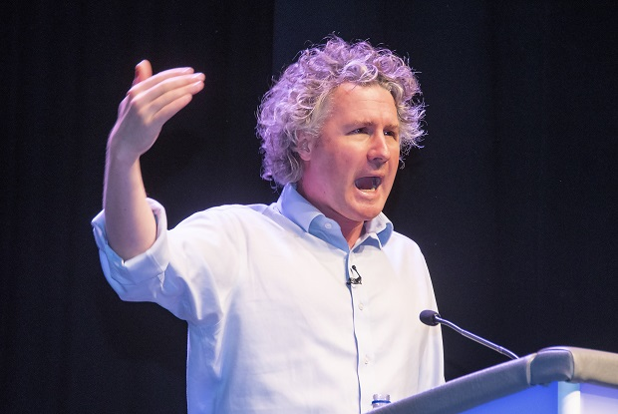
Goldacre Review
“Moving to working with NHS data in shared TREs will… [allow researchers to] …work on it securely, in situ, without downloading it off site, using standard environments that share code and working practices.”

Slide 7
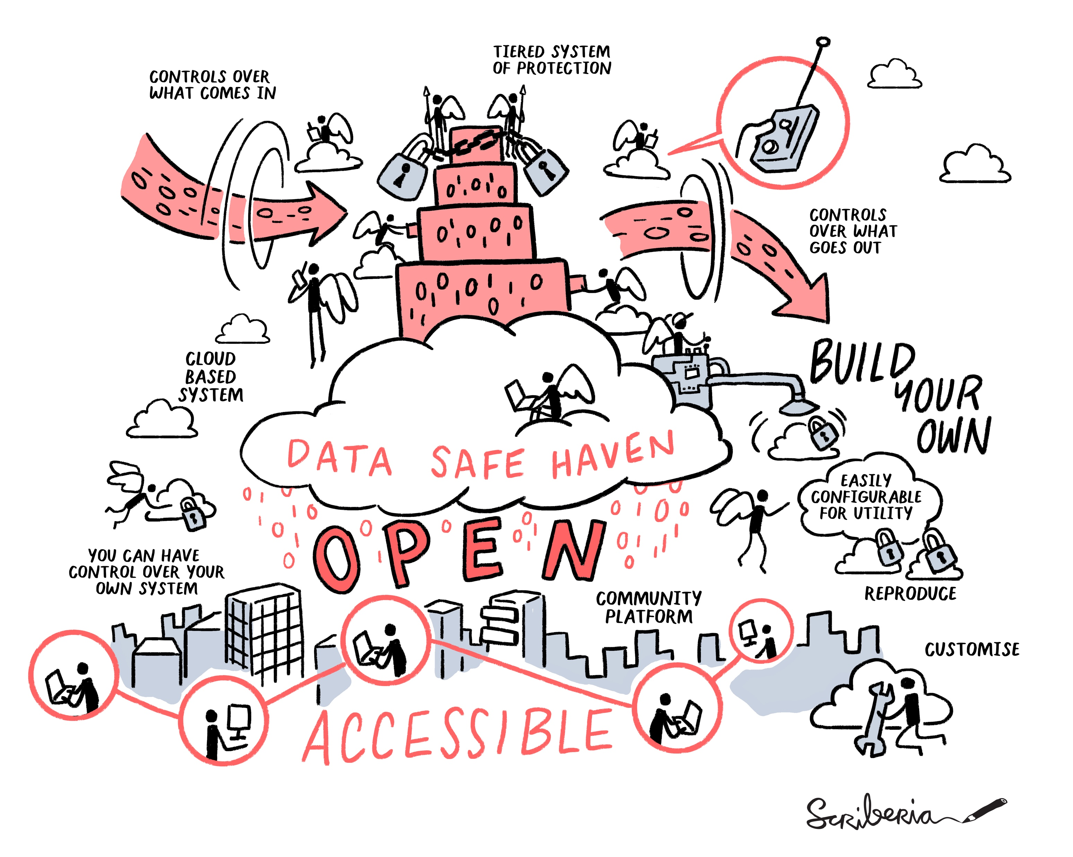
An example of a TRE from the Turing
Framework for agreeing data sensitivity
Software-defined reproducible deployment to Azure cloud
Single isolated TRE per-project
Easy to deploy or tear down as needed
It’s not a service offered by Turing, it’s an open-source codebase for building your own

Slide 8
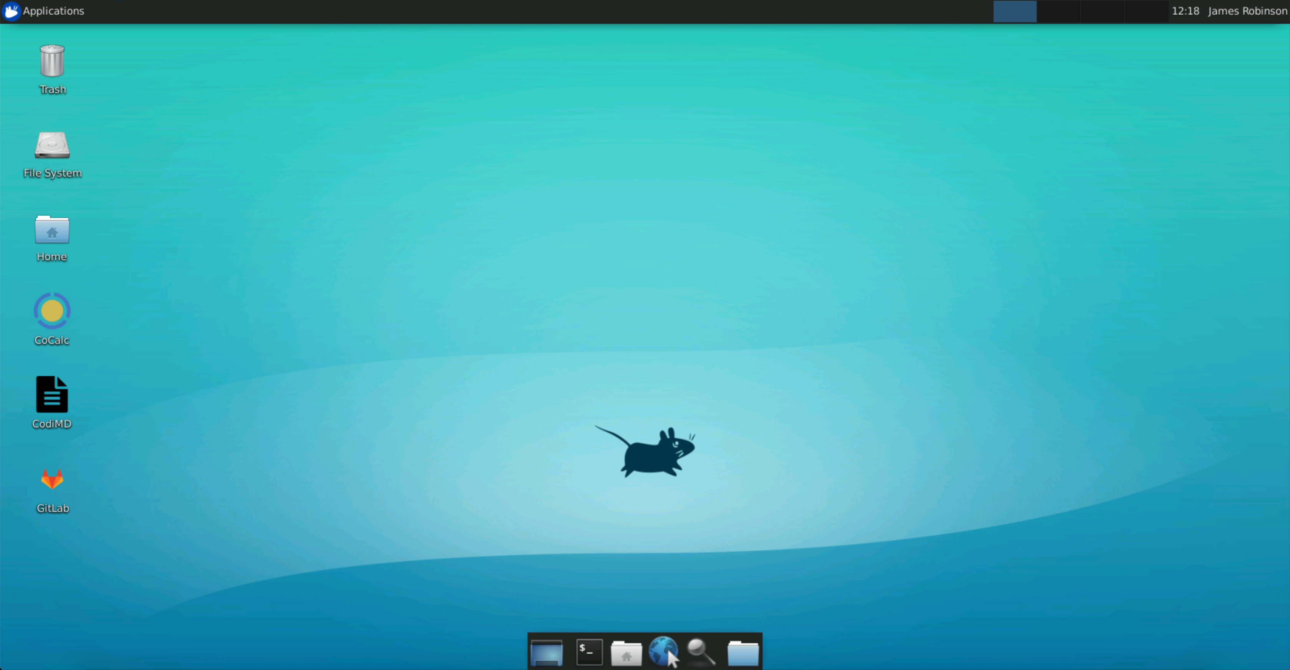
Connection are only permitted via an in-browser remote desktop
Users must authenticate with password and multi-factor authentication
Wide range of data science tools pre-installed to support offline work
Offline copies of Python and R package repositories
Ability to install additional software as agreed by project

Slide 9
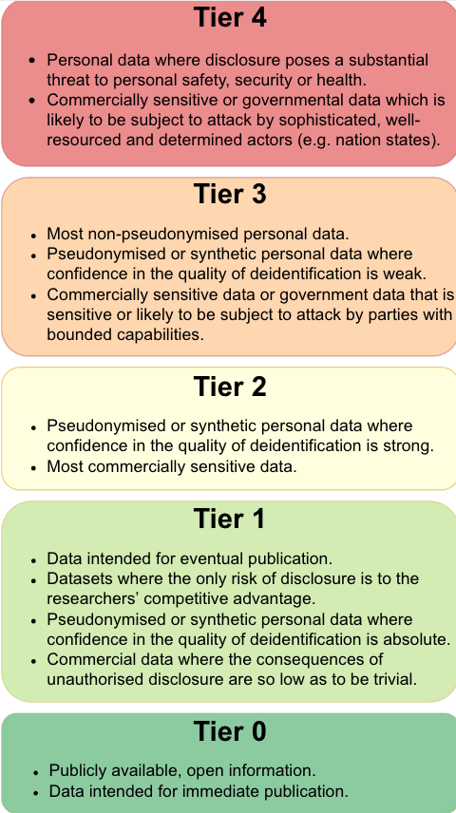
Tier 4
Tier 3
Tier 2
Tier 1
Tier 0

Slide 10

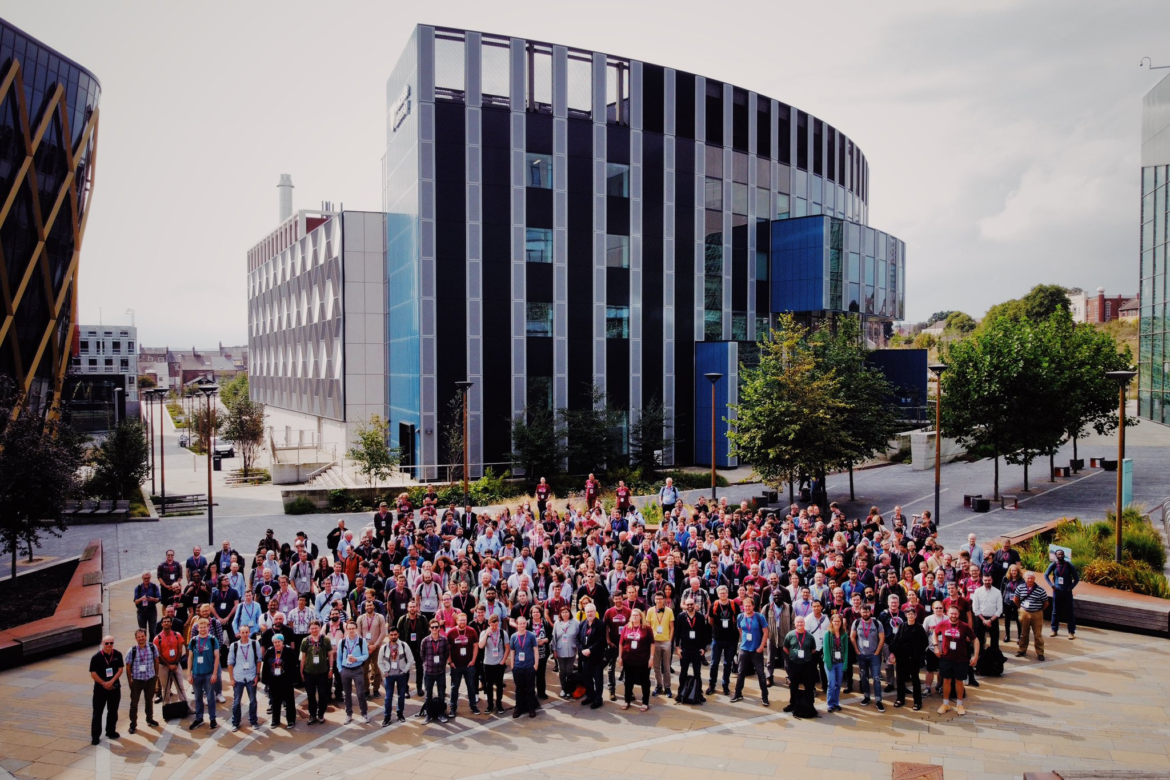
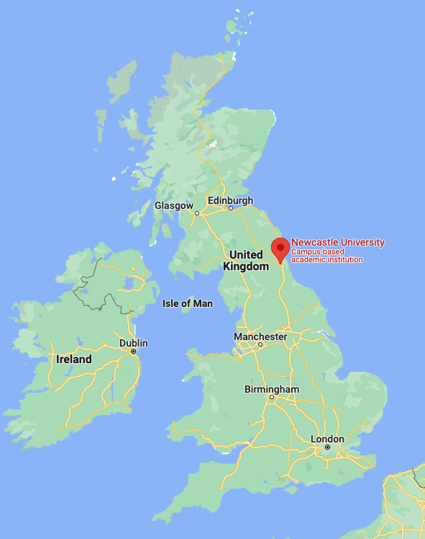
RSECon22
We presented DSH at RSECon
Heard from other TRE developers
Result is a new community:
https://rse-tre-community.readthedocs.io/en/latest/

Slide 11


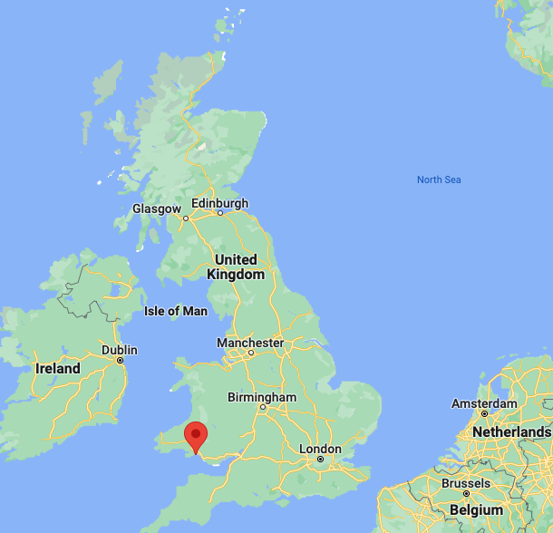
Wales Multimorbidity Machine Learning Project
As a member of the REG, I was tasked with helping researchers get the most out of their TRE, the SAIL databank.
I chose to write a report, that can be used as a guide for both this and future TRE projects.
In particular, they needed help with:
Using their TRE effectively
How to publish their research code
Considerations around working with sensitive data
Best practices for research code and reproducible data science

Slide 12
Research code best practices applicable to TREs
Developing research code as modular scripts and utilising version control software such as GitLab or GitHub.
Using unit testing, quality checks and continuous integration to ensure that research code works as expected.
Using Jupyter or R Markdown notebooks for data analysis and, where appropriate, the drafting of research papers.
Making use of DOIs (digital object identifiers), citation files and software licences when publishing research software.

Slide 13
TRE specific research code best practices
Considering the advantages and disadvantages associated with where research code destined for publication is developed, either inside or outside the TRE.
Taking care to minimise the risk of data leakage when exporting any research outputs from the TRE.
Exploring the options for researchers who lack immediate access to a TRE, or the dataset they’ll be working with e.g. synthetic data

Slide 14
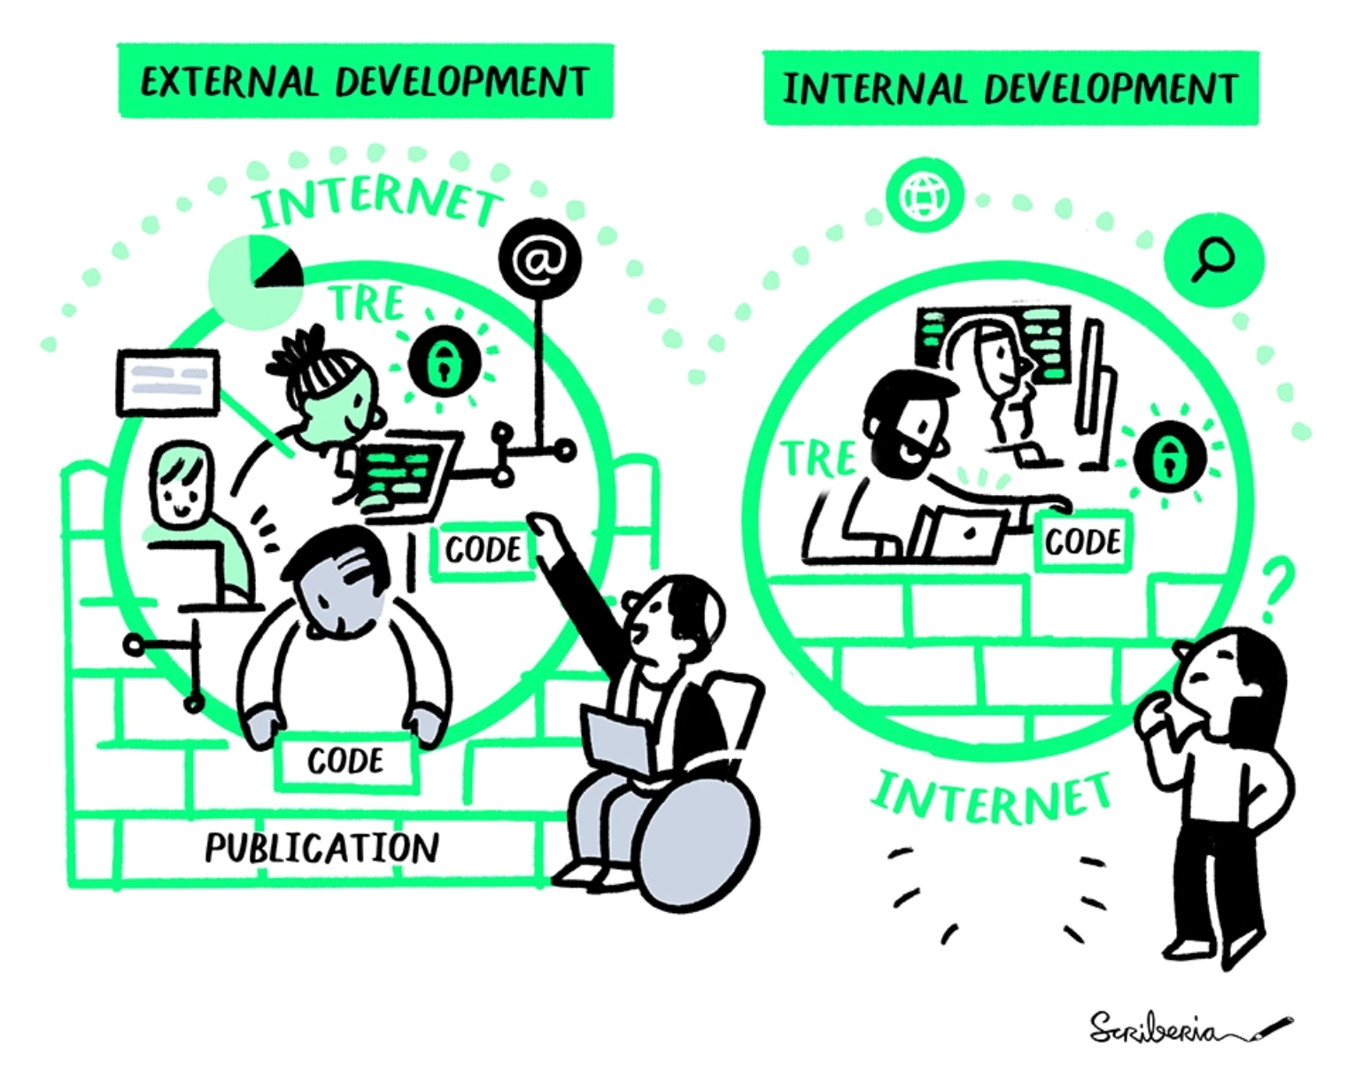
To TRE or not to TRE…
Where should researchers write their TRE code?
What should be exported from the TRE for publication purposes?

Slide 15
Developing and Publishing Code for Trusted Research Environments: Best Practices and Ways of Working
Blog: https://www.turing.ac.uk/blog/towards-set-best-practices-doing-research-trusted-research-environments
Full report: https://zenodo.org/record/5675093#.Yw4aPuzMJhH

Slide 16
Data Safe Haven & TRE Development
Website: https://www.turing.ac.uk/research/research-projects/data-safe-havens-cloud
Documentation: https://alan-turing-institute.github.io/data-safe-haven/develop
RSE-TRE-Working-Group: https://rse-tre-community.readthedocs.io/en/latest/

Slide 17
Any questions?
…

