Slide 1

Dr Lynne Adair (Forrest)
Data Curation Manager
Developing an RDS strategy for the production and research use of synthetic data for Scotland

Slide 2
RDS Mission Statement
To promote and advance health and social wellbeing in Scotland by enabling access to public sector data about people, places and businesses for research in the public good

Slide 3







Founder Members of RDS
RDS
Joining Members of RDS (2022)
Notes:
Research Data Scotland is a new organization/service which offers a single point of contact for help accessing public sector data in a safe, secure and cost-effective way for research purposes, innovation and investment that brings public benefit.
a partnership that includes the Scottish Government, other public bodies such as Public Health Scotland, National Records of Scotland, and working in partnership with organisations such as Edinburgh Parallel Computing Centre and various Scottish universities and regional safe havens
Partners:
ADR-S– through SG
ADR-UK
EPCC – (part of University of Edinburgh)
eDRIS (part of PHS)
NRS
SCADR (Uni of Edinburgh, SG etc.)
HDR-UK
Regional Safe Havens (a mix of health boards and universities)
ONS

Slide 4

RDS principles
Only enable access to data for research for public good​
Only access data once an individual’s personal identity has been removed
All data is always kept in a controlled and secured environment​
All income that RDS generates will be re-invested into service
RDS will be transparent
Firms that access public data for the public good through RDS will share any commercial benefits back to improve public services​

Slide 5
LA Background
Admin data researcher for 10 years
Research Support for 4 years
Worked at ADRC-S, SCADR and Scottish Longitudinal Study (SLS)
Developed synthetic datasets for SLS researchers using Synthpop package
Worked at RDS for 11 weeks…
Remit: develop a synthetic data strategy

Slide 6
Synthetic Data Definition
‘Synthetic data are modelled statistical outputs released in a format that closely resembles the confidential data format’
US Census Bureau
‘A new copy of a data set that is generated at random but made to follow the structure and some of the patterns of the original data set’
‘Accelerating public policy research with synthetic data’: ADR-UK Report Dec 2021
Notes:
‘a new copy of a data set that is generated at random but made to follow the structure and some of the patterns of the original data set. Each piece of information in the data set is meant to be plausible, but it is chosen randomly from the range of possible values, not by pointing to any original individual in the data set’

Slide 7
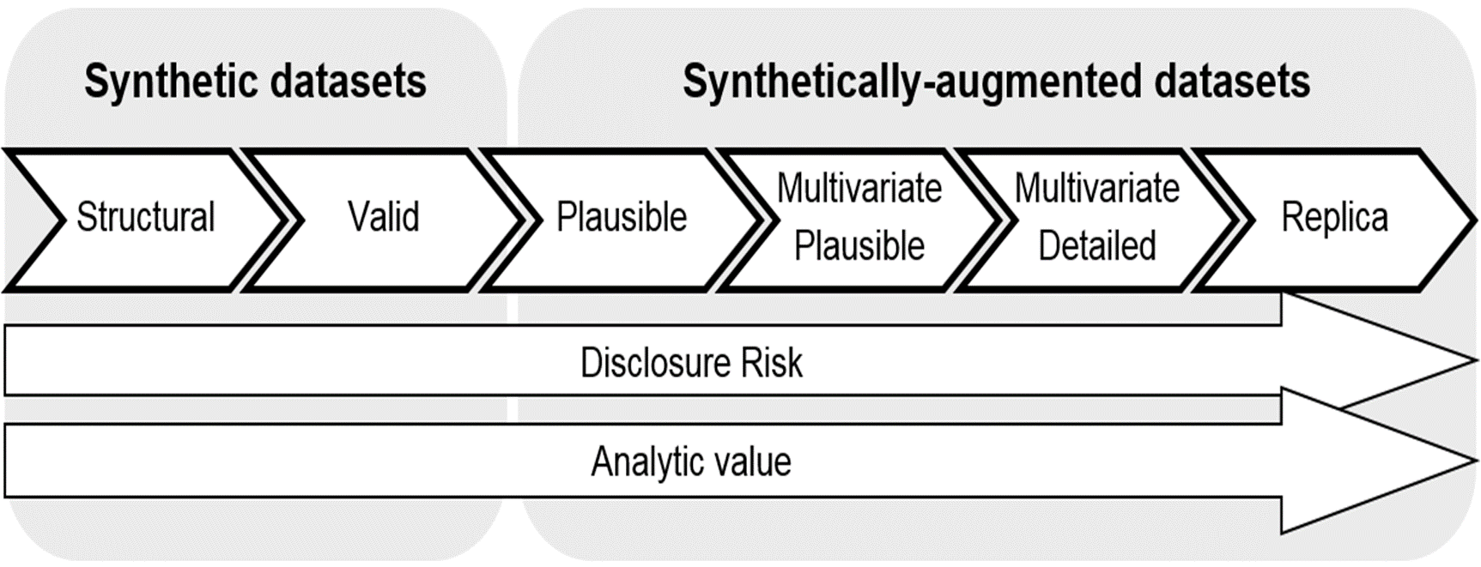
Spectrum
  Low fidelity to high fidelity
ONS methodology working paper series number 16 - Synthetic data pilot - Office for National Statistics
Notes:
low fidelity: can be defined as ‘very basic representations of the original data that have no disclosure risk (e.g., by preserving only the data type, format and structure and univariate characteristics)’. High fidelity data has ‘detailed and accurate representations of the original data for which disclosure control will be critical’.
Structural, univariate, multivariate, multivariate plausible and more (ADR)
Structural, Structural/valid, Synthetic-augmented, Synthetic replica (RSH)

Slide 8
Scoping
Investigate what other data organisations are doing around synthetic data: RSHs, PHS, ONS, NSS, HDRUK, ADR-UK
What experience do you have in using synthetic data?
What purposes do you use synthetic data for? What would you like to use it for?
What tools are you using/planning to use?
What are the issues you’ve experienced?
Discussions used to identify what the RDS synthetic data strategy might include

Slide 9
Synthetic data landscape
Several organisations have created ad-hoc, low-fidelity synthetic data using bespoke code in R/python/other, and this is fairly easy to do
For production of high-fidelity data, and scaling up of synthetic data production, synthetic data tool would be useful
Work needs to be done to determine the most suitable tool(s)
  Ability to deal with different data types and relationships, handle large numbers of variable categories and deal with temporal data
  Different tools for different fidelity requirements?
  Commercial v open-source
  Commercial tools – expense v utility
Notes:
Work needs to be done to determine the most suitable tools in terms of their ability to deal with different data types and relationships, handle large numbers of variable categories and deal with temporal data
Different tools for different fidelity requirements?
Some tools from commercial companies are very expensive and so expense has to be weighed against the utility

Slide 10
Synthetic data landscape
Addressing privacy concerns – public and data controllers
Information Governance (IG) challenges on trying to release high fidelity data
How to measure how closely the synthetic data resembles the real thing and thus is a disclosure risk
  Standardisation of the different types of synthetic data and the terminology around this is required
Notes:
Use different levels to categorise the data
eg if level 1 were the least disclosive then this could be generally released
Level 4 would require safe haven only access
Data controllers could clearly see the risk level of each type of synthetic data and thus simplify the IG decision-making process

Slide 11
Uses of synthetic data
Training in using linked administrative data
Data discovery (augment metadata catalogue)
Code development:
  Writing and testing code before full data access is available
  To limit safe setting access to real data
AI/Model training

Slide 12
Synthetic data benefits
To researchers and data controllers:
  Upskill users in use of admin data by using synthetic data as a training resource
  Better data discovery (can augment meta data catalogue)
  Reduce time needed in secure settings and with access to real data
Public/Generally:
  Greater use of data

Slide 13
Access methods/location
Safe haven
Data in safe haven but accessed via VPN from elsewhere
Analytical Workbench
Dataset released to researcher after signing an undertaking form
Published on website
Training/Accreditation Requirements
None
Researcher at approved institution
RDS Approved researcher accreditation (RDS ARA)
RDS ARA + ONS Safe Researcher Training

Slide 14
Plans
Set up a Scottish working group to identify similarities and differences in synthetic data needs, governance, and access for different organisations
Survey researchers/users on their synthetic data requirements
Speak to data controllers re their understanding and concerns around synthetic data
Supply IG and legal expertise
Public engagement

Slide 15
Plans
Fund work to :
  Investigate synthetic data tools and synthetic data requirements
    Evaluate and compare commercial and open-source tools
    Cost-benefit analysis
    Different solutions for low- and high-fidelity synthesis?
  Develop a standardised synthetic data classification system to help understand the fidelity and risk of the synthetic data
  Develop an example synthetic dataset (low- and high-fidelity versions)
Notes:
Develop a standardised synthetic data classification system that can be used to help data controllers easily understand the fidelity and risk of the synthetic data
Investigate ways of automating synthetic data production

Slide 16
Proposed Outcomes
A test synthetic dataset
A data/tools matrix to allow selection of the most appropriate tool and level of fidelity required for production of different types of synthetic data
A clear synthetic data classification system in terms of fidelity and risk that can be used when speaking to data controllers
  Specify training and IG requirements, access methods and location for each synthetic data classification
For the future: Synthetic datasets for training, data discovery and code development

Slide 17
Questions
What experience do you have in using synthetic data?
What purposes do you use synthetic data for? What would you like to use it for?
What tools are you using/planning to use?
What are the issues you’ve experienced?
Anything we should consider that hasn’t been covered?

Slide 18
Thank You
Dr Lynne Adair (Forrest)
Data Curation Manager
lynne.adair@researchdata.scot
Twitter:
@DrLynneAdair
@RDS_Scotland
Website: https://researchdata.scot

