Slide 1
Group disclosure

Slide 2
Group disclosure
Group disclosure can occur when one cell accounts for a very high percentage of a row or column total.
When a single cell accounts for a very high percentage of a row or column, there is a natural tendency to attribute this characteristic to anyone who may be in this group.
For example:
A recent survey of drug use in a school found that 95% of pupils had tried illegal drugs within the previous year.
What might be the assumptions made if this figure is reported?
Notes:
Very high percentage of a row or column total - normally it would be considered problematic if a cell accounted for close to 100% of a row total (90% and up). This is also true for the converse, if a cell accounts for a very low percentage, it can be inferred that a large percentage of observations did not report the variable.
In this example, it would appear that a very high percentage of pupils had tried drugs. If we had this presented as a table, with a column for having taken drugs, and another indicating the pupils who had not, the cell for pupils having taken drugs is close to 100%. If a parent of one of the students saw this figure, they may conclude that their child had taken drugs, as the percentage of those who have is so high. This would then be attributing drug use to a student for whom it may not be true, or who may not even have been surveyed. When working with sensitive variables, we would not want statistics to cause such assumptions to be made.

Slide 3
Group Disclosure (Example 1)
Cancer survival rate by social class – example data
Social Class | 1 Year | 2 Years | 3 Years | 4 Years | 5 Years | Count
I | 92% | 83% | 75% | 69% | 62% | 8521
II | 92% | 80% | 72% | 67% | 63% | 10143
III – non-manual | 80% | 71% | 60% | 52% | 47% | 20875
III – manual | 68% | 64% | 59% | 50% | 42% | 25491
IV | 55% | 42% | 37% | 33% | 28% | 12096
V | 38% | 26% | 19% | 8% | 0% | 3661
How many observations are in each cell?
Notes:
Social class is ONS classification with I being the more financially well-off and V being the lowest.
The first issue with this output is that the researcher has provided overall counts but not the counts for each cell which would be expected. It would not be good practice to burden the output checkers unduly by expecting them to calculate the actual figures.
Go to next slide to show the counts.

Slide 4
Group Disclosure (Example 1 - Frequencies)
Cancer survival rate by social class – example data
Social Class | 1 Year | 2 Years | 3 Years | 4 Years | 5 Years | Count
I | 7839 | 7070 | 6388 | 5875 | 5283 | 8521
II | 9332 | 8112 | 7304 | 6792 | 6390 | 10143
III – non-manual | 16697 | 14819 | 12521 | 10855 | 9808 | 20875
III – manual | 17330 | 16318 | 15036 | 12740 | 10709 | 25491
IV | 6652 | 5078 | 4476 | 3989 | 3383 | 12096
V | 1391 | 952 | 692 | 290 | 0 | 3661
Number of observations are clear
Is a 0 a problem in this context?
Notes:
Here we can see the underlying counts for the previous table. None of the cells has a value below the threshold as such, but there is a 0 for 5 years for class V.
Is this is a problem? After all it applies to no-one so there is not primary disclosure as such.
There is an issue here. From this table we could infer that someone you knew who would be categorised as social class V is highly unlikely to survive more than 5 years. It is unlikely that someone would want this known. We have learned something about a whole group of people that is potentially sensitive to them. It may not also be true for everyone, so we might be misattributing this characteristic to someone.

Slide 5
Group Disclosure (Example 2)
Breakdown of main cause of workplace injuries by profession
Profession | Tripping/Falls | Repetitive Strain Injury | Heavy Machinery | Other | Observations
Doctor | 8% | 22% | 0% | 70% | 732
Builder | 24% | 19% | 3% | 54% | 1485
Banker | 18% | 17% | 0% | 65% | 509
Notes:
Are there any issues here? We haven’t been provided with the counts.

Slide 6
Group Disclosure (Example 2 - Frequencies)
Breakdown of main cause of workplace injuries by profession
Profession | Tripping/Falls | Repetitive Strain Injury | Heavy Machinery | Other | Observations
Doctor | 58 | 164 | 0 | 510 | 732
Builder | 355 | 283 | 45 | 802 | 1485
Banker | 92 | 87 | 0 | 330 | 509
Is a 0 a problem in this context?
Notes:
In this case probably not. We would not expect doctors and bankers to come into contact with heavy machinery (although not impossible) and so it is logical that this is 0. We haven’t learned anything about these professions that could be sensitive. We would refer to these as ‘logical zeroes’.
This examples applies for a principles-based approach to SDC – a rules-based approach would not allow this form of group disclosure.

Slide 7


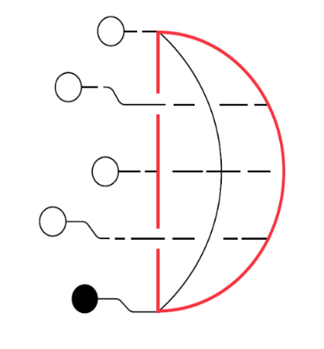


Assessments for this module
SDAP: Safe Analyst Training - Group Disclosure
Created by Cancer Research UK, DKFZ, and The Health Foundation for the Safe Data Access Professionals Working Group

