Slide 1
Introduction to Safe Projects and Safe People

Slide 2
Safe Projects
Safe Projects are those that justify the use of the personal data. This justification could be that the expected outputs of the research will have an important public benefit.
It is important to consider if the project could be achieved without accessing the personal data. It would not be considered a Safe Project if the same outputs could be produced using anonymous or aggregate data.
Very often the decision on whether a project is ‘safe’ is taken by other stakeholders during the application process for accessing data, for example by the Data Access Request Service at NHS Digital.
Research is reliant on there being public support for research access to personal data and a positive public perception toward the research community. Considering if a project is ‘safe’ helps reduce the chance of negative publicity.
Notes:
Under the legitimate interest legal basis of the GDPR it is necessary to consider if the interest outweighs the risks to personal privacy. A Safe Project is a similar assessment, does the project’s validity outweigh the risk?
It is useful to consider the Safe Project concept even when you are using data that is not held elsewhere, it can help avoid public criticism for your work.
Imagine if a very basic description of your project appeared as a tabloid headline – would someone who saw the headline think your project sounded reasonable?

Slide 3
Ethical Projects
When considering if a project is ‘safe’ it may also be useful to consider the impact of the work on the data subjects and how the project will be ethically conducted.
This consideration may differ from your legal obligations:
  It may be possible to access data without consent i.e. using legitimate interest as a legal basis.
  However, it may be good practice to engage with data subjects or their representatives to review what concerns they might have about your project.
  This engagement can reassure data subjects about the use of their data. It can also improve your project design.
The project should also be conducted ethically.
  Are any results published an honest account of your findings?
  Have you been open and transparent with your methods so that others may review your work?
  Does your work have the potential to negatively impact any group, particularly those that already experience marginalisation?
Notes:
We want to highlight that there may be wider implications to research which go beyond the legal obligations for researchers.
By thinking ethically we can possibly avoid the careless use of data which may harm the data subjects or undermine confidence in the research community.
It may be more difficult to be transparent when working with sensitive data that cannot be easily shared, but it is possible to provide detailed methodology information. Some services may even allow you to request Stata do files or R scripts that can provide other researchers a clear view of what you did in your project.

Slide 4
Safe Project Assessment
Would you consider the following projects to be ‘safe’?
A project wishes to access health records without patient consent. This is to be done in order to ascertain if a recent health care policy change has had a negative impact on patients.
A tobacco company wishes to access a longitudinal social survey. The people involved in the survey were asked about their smoking status. The tobacco company wishes to use the data to identify the best places for advertising.
A person wishes to access confidential crime data. They know that their neighbour was recently a victim of crime and wants to find out more so that they can better support them.
A large technology company wishes to access patient health data in order to develop diagnostic AI. Consent is not required but no patient engagement has taken place. The company has a poor reputation with regard to privacy and this project is outside of their usual business area.
Notes:
These projects should be discussed by the group of trainees.
This is likely to be considered safe, the outcome would have a public benefit even though the data is being collected without consent.
This would not be considered safe, there is no public benefit to the research and the data
This would not be considered safe. Although they wish to help their neighbour it is inappropriate to use research data to identify people.
This could be debated either way. To argue this is safe, we could consider that the consent would not be required necessarily and the project is likely to have a positive benefit to patients. To argue that this is unsafe, we might consider what the public perception is likely to be being that the company has a poor reputation and this is not an area that we would expect the company to be involved with.

Slide 5
Safe People
When accessing confidential data, e.g. in a Safe Setting, it’s essential that only Safe People can access the data.
Why is this important?
Notes:
Why is it important should be a point of discussion, possible areas to discuss:
Generally the staff at the secure environment will not be watching the researchers non-stop, and so are reliant on them to act appropriately at all times.
A research environment that is 100% safe is likely to be so locked down that ease of use is severely impact, environments have generally been designed to be a compromise between ease of use and security, and an unsafe person may be able to exploit any compromises.
It is important that the public/data subjects are supportive of the research use of their data. One bad researcher could potentially damage the entire research community if they undermine public confidence.

Slide 6
Importance of Safe People
Avoid mistakes that might lead to confidential data being exposed.
Ensures that only people with the right motivation access confidential data.
Encourage data owners to make data available to the research community.
Maintain public trust and confidence.
Notes:
Mistakes are more common than deliberate misuse, so it is important that researchers are aware of how to work safely. Even a well-intentioned researcher can make mistakes.
Safe People access data for research purposes, rather than to miss use data
Data owners are usually risk adverse, they are more likely to make data available for research purposes if they have confidence in the researchers that will be using it.
The same is true for the public, who might be unwilling to allow their data to be used if research use often leads to disclosure.

Slide 7
What does it take to be a Safe Person?
Appreciation of confidential data: the data do not belong to us just because we have access to the data for research.
Appreciate the ethical use of data.
No incentive to ‘misuse’ the data (e.g. selling on to others).
Understanding the consequences of misuse.
Willing to work with Safe Setting staff to achieve Safe Use of data together.
If they notice something is not quite right, or not convenient for them, will liaise with Safe Setting staff constructively.
Notes:
Stress the importance of having the ‘right’ attitude when working with confidential data. A Safe Person will not necessary remember every point, but they will seek guidance and support when they are unsure.
It is also important to highlight the necessity to work with staff of the Safe Setting. The role of staff is not to police researchers but to support their work. We don’t want to foster an adversarial relationship.
Staff should also be responsive to the requirements of researchers, if researchers are frustrated by the setting they may look for workarounds.

Slide 8


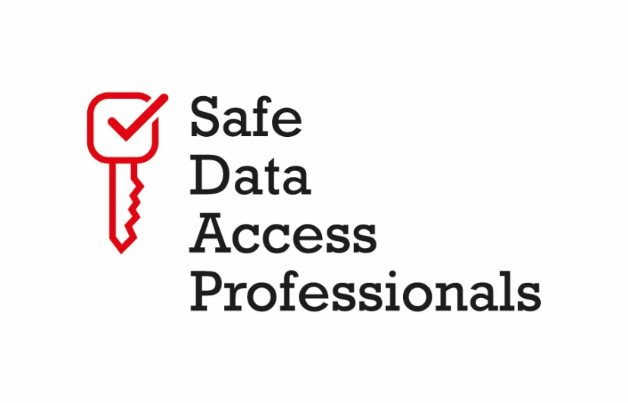


Assessments for this module
SDAP: Safe Analyst Training – Introduction to Safe Projects and Safe People
Created by Cancer Research UK, DKFZ, and The Health Foundation for the Safe Data Access Professionals Working Group

